Slide 1

Exploratory and Data Mining Analysis in Big Data Environment
Tin Ivan Križ
Mentor: izv. prof. dr. sc. Damir Pintar Faculty of Electrical Engineering and Computing

Slide 2
Overview
Big data
Data growth
What is big data?
Potential of big data
Apache Spark and its R integration
Apache Spark
the R interface to Apache Spark
A practical example of big data analysis
Introduction to the analysis
Exploratory data analysis
Data mining
Conclusion to the analysis and future work

Slide 3

1 Big data

Slide 4






Data growth
Today:
4.3 billion people use the internet
2.7 billion people use Facebook on a monthly basis
2.7 billion people own a smartphone
26 billion IoT devices are connected to the internet
In one minute:
50,000 pictures are posted on Instagram
4.5 million YouTube videos are viewed
475,000 tweets are posted
510,000 comments, 293,000 posts and 136,000 pictures are uploaded to Facebook
around a quadrillion of bytes of data is generated on average

Slide 5
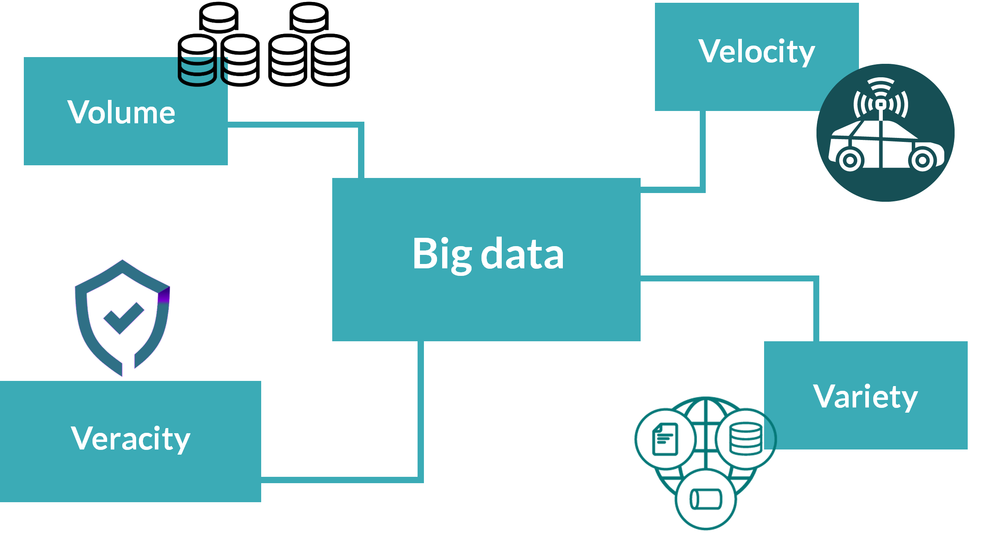
What is big data?

Slide 6

What is big data?

Slide 7
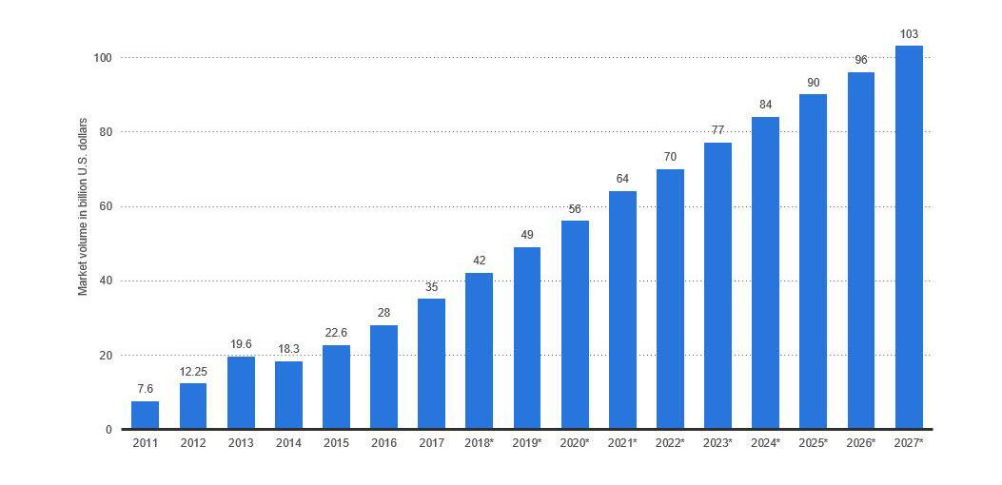
Potential of big data
Big data market volume is ~$56 billion in the USA in 2020

Slide 8
2 Apache Spark and its R integration

Slide 9

2.1 Apache Spark

Slide 10
About Apache Spark
distributed data processing engine
performs data processing in RAM
most actively developed
supports: Java, Scala, Python and R

Slide 11

2.2 The R interface to Apache Spark

Slide 12
About the R language
second most popular language for data analysis, after Python
designed by statisticians for statisticians = ease of use
large community = rich package archive and support

Slide 13
Package sparkly
R interface to Apache Spark
built on top of popular dplyr package
higher level of abstraction = less Spark details, but also less functionalities
supports almost all MLlib machine learning models

Slide 14
3 A practical example of big data analysis

Slide 15
3.1 Introduction to the analysis

Slide 16
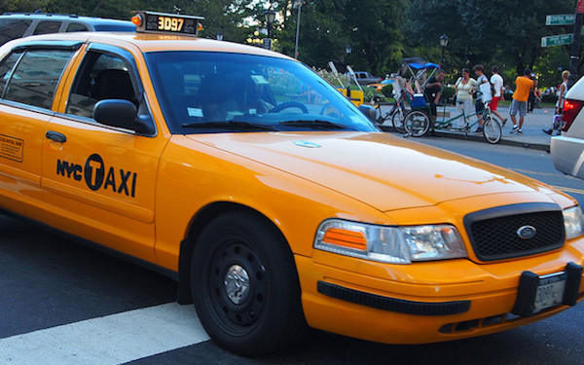



Use case: Tips in NYC taxis
Data
Goal
Infrastructure
Notes:
the infrastructure was run on a cluster of 8 nodes with 2 GB of RAM each on FER!!!

Slide 17
3.2 Domain research

Slide 18




Role of tipping in the United States’ economy
Tip is a voluntary addition to the basic price of the service
Dates back to the 19th century in the United States
Tipped professions include a wide range of jobs

Slide 19
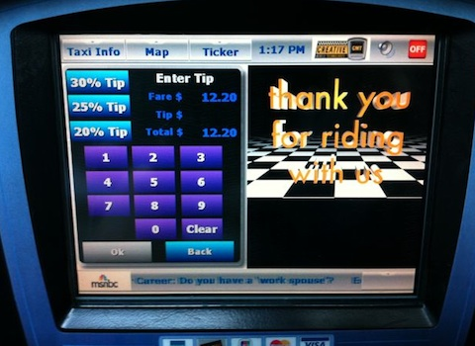
Tipping in NYC taxis
Every car contains a device
Customers can choose between default tip options - 20, 25, 30 %

Slide 20


Value of the research
Better approximation of cash tips for taxi companies
Increase of taxi driver’s income Revenue of taxi & limousine services in United States in 2019: ~$31 billion which means that there is approximately ~$4.65 billion (15%) generated in tips. Increase of merely 0.1% would be worth ~$4.65 million for the industry
research may be useful for the general psychological and economical scientific research of the tipping system

Slide 21
3.3 Exploratory data analysis

Slide 22
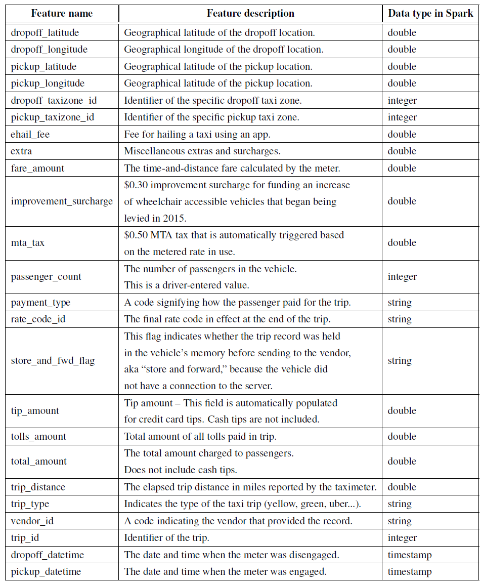
Dataset
official dataset published by the NYC Taxi & Limousine commission
32.6 GB in parquet format
over 1.3 billion taxi rides
January 2009 to June 2016
24 features
Notes:
only used 13

Slide 23
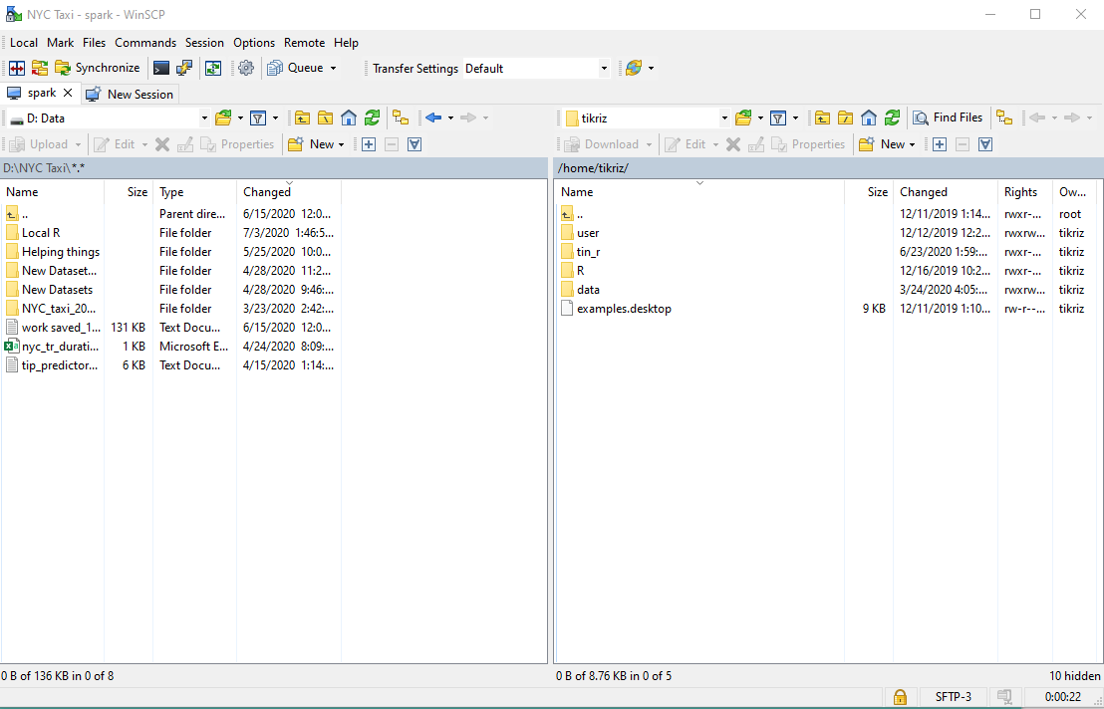

How to do it?
How I did it?
Importing dataset - 1) Transfer to cluster

Slide 24
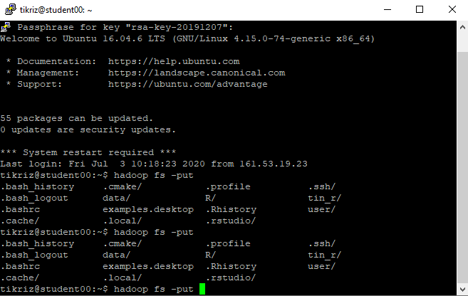

How to do it?
How I did it?
Importing dataset - 2) Copy to files to HDFS

Slide 25
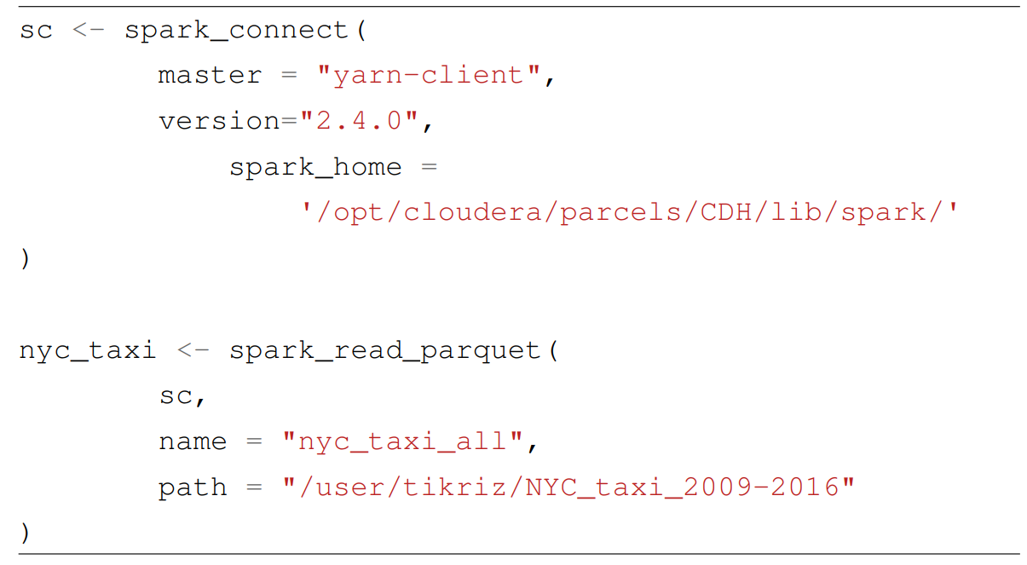
How to do it?
How I did it?
Importing dataset - 3) Load data in R

Slide 26
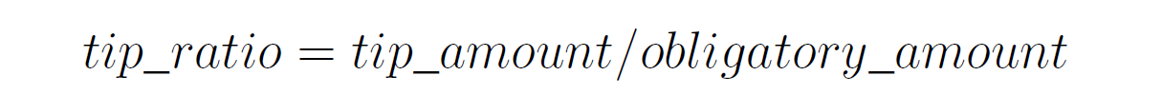
Defining the goal feature - tip ratio
%
Notes:
SAy its additionally rounded to 3 decimal points!

Slide 27
Data quality
Removed missing values
Kept only taxi rides paid by credit card
Removed rows containing impossible or highly improbable values
1,382,375,998 => 576,229,728 rows

Slide 28
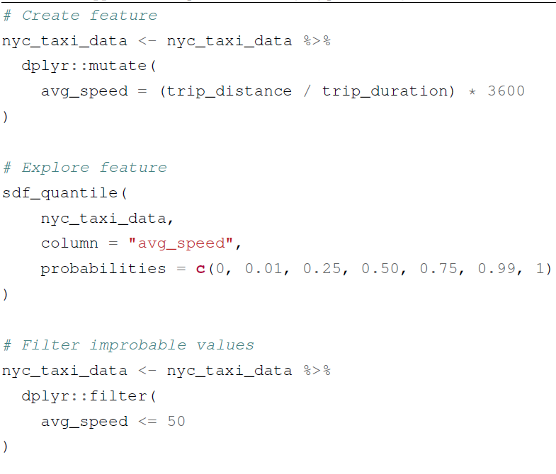
How to do it?
Data quality and wrangling using sparklyr
Quantile | Avg speed (m/h)
0.00 (min) | -1183.20
0.01 | 2.47
0.25 | 8.56
0.50 | 11.60
0.75 | 15.75
0.99 | 36.60
1.00 (max) | 3079127373
=>

Slide 29
Data exploration and feature engineering

Slide 30






Data exploration and feature engineering
Ride type (1)
ride type
Route-related features (4)
ride distance
direct (aerial) distance
ride duration
obligatory price
Performance-related features (2)
average vehicle speed
ineffectiveness
Time-related features (4)
ride hour
ride day of week
ride month
ride year
Features integrated from location data (6)
pickup/dropoff taxizone
pickup/dropoff borough (area)
going to/from airport
Features integrated from weather data (6)
precipitation
snowfall
snow depth
average wind speed
min/max temperature

Slide 31
Ride type

Slide 32
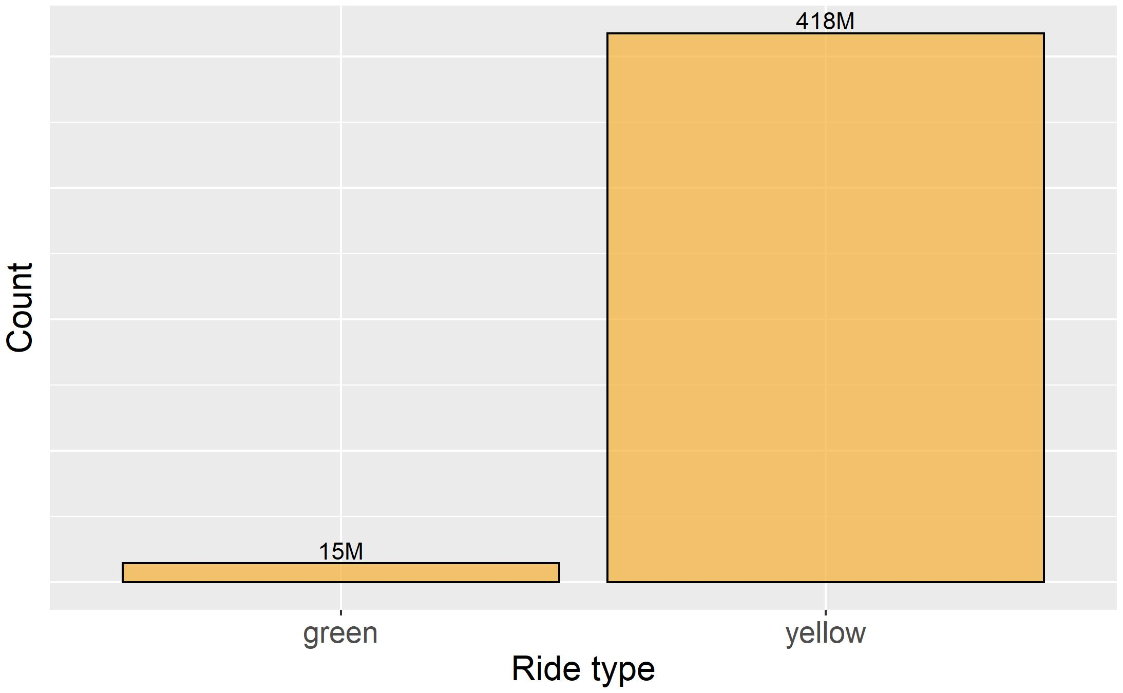
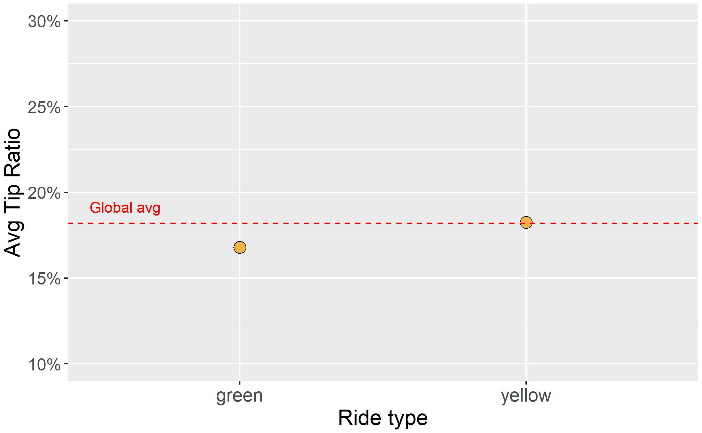
Ride type

Slide 33
Route-related features

Slide 34
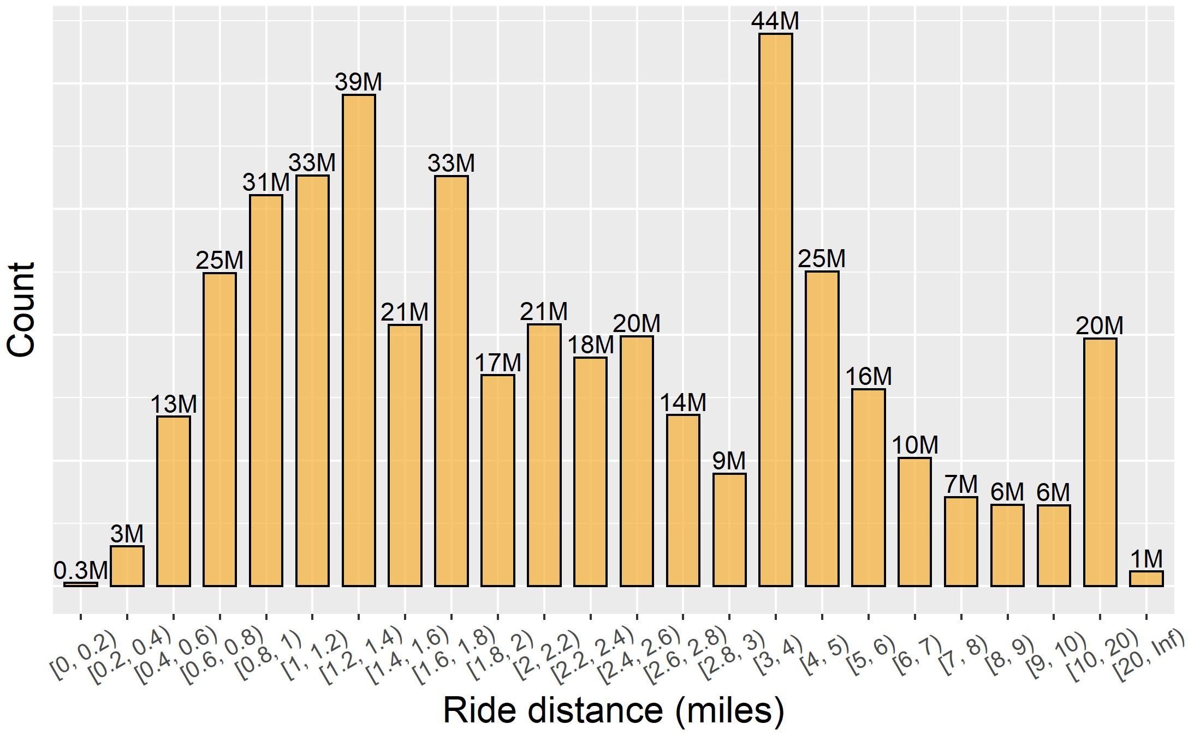
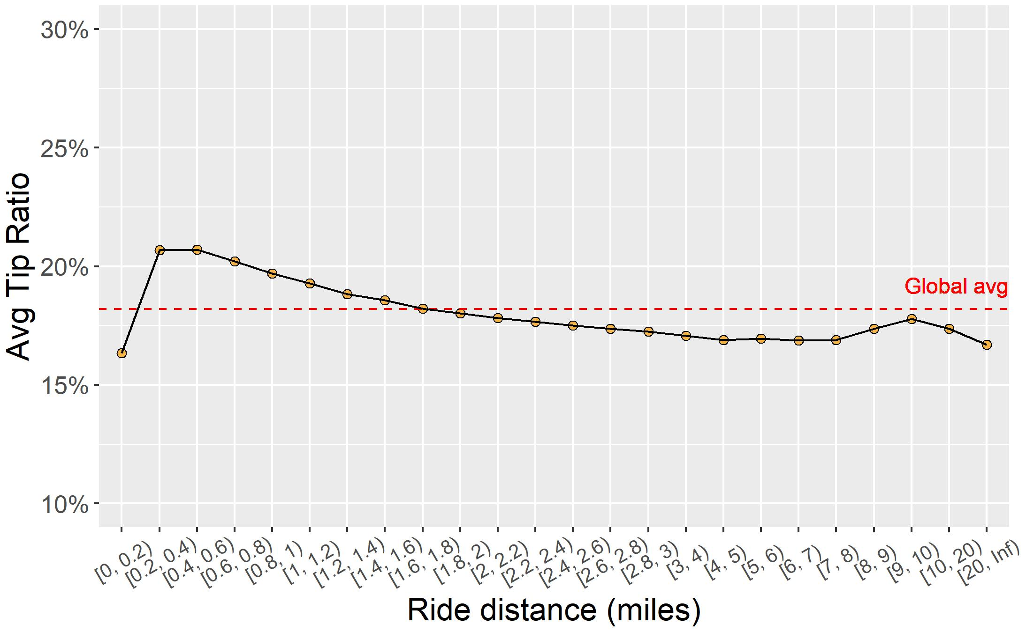
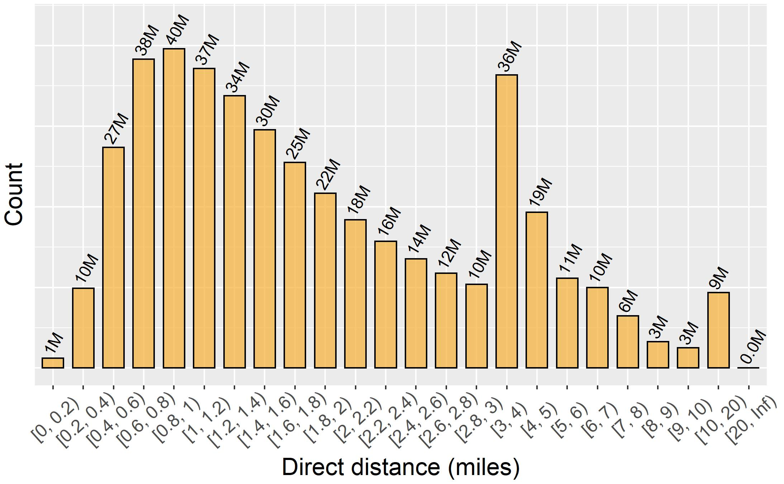
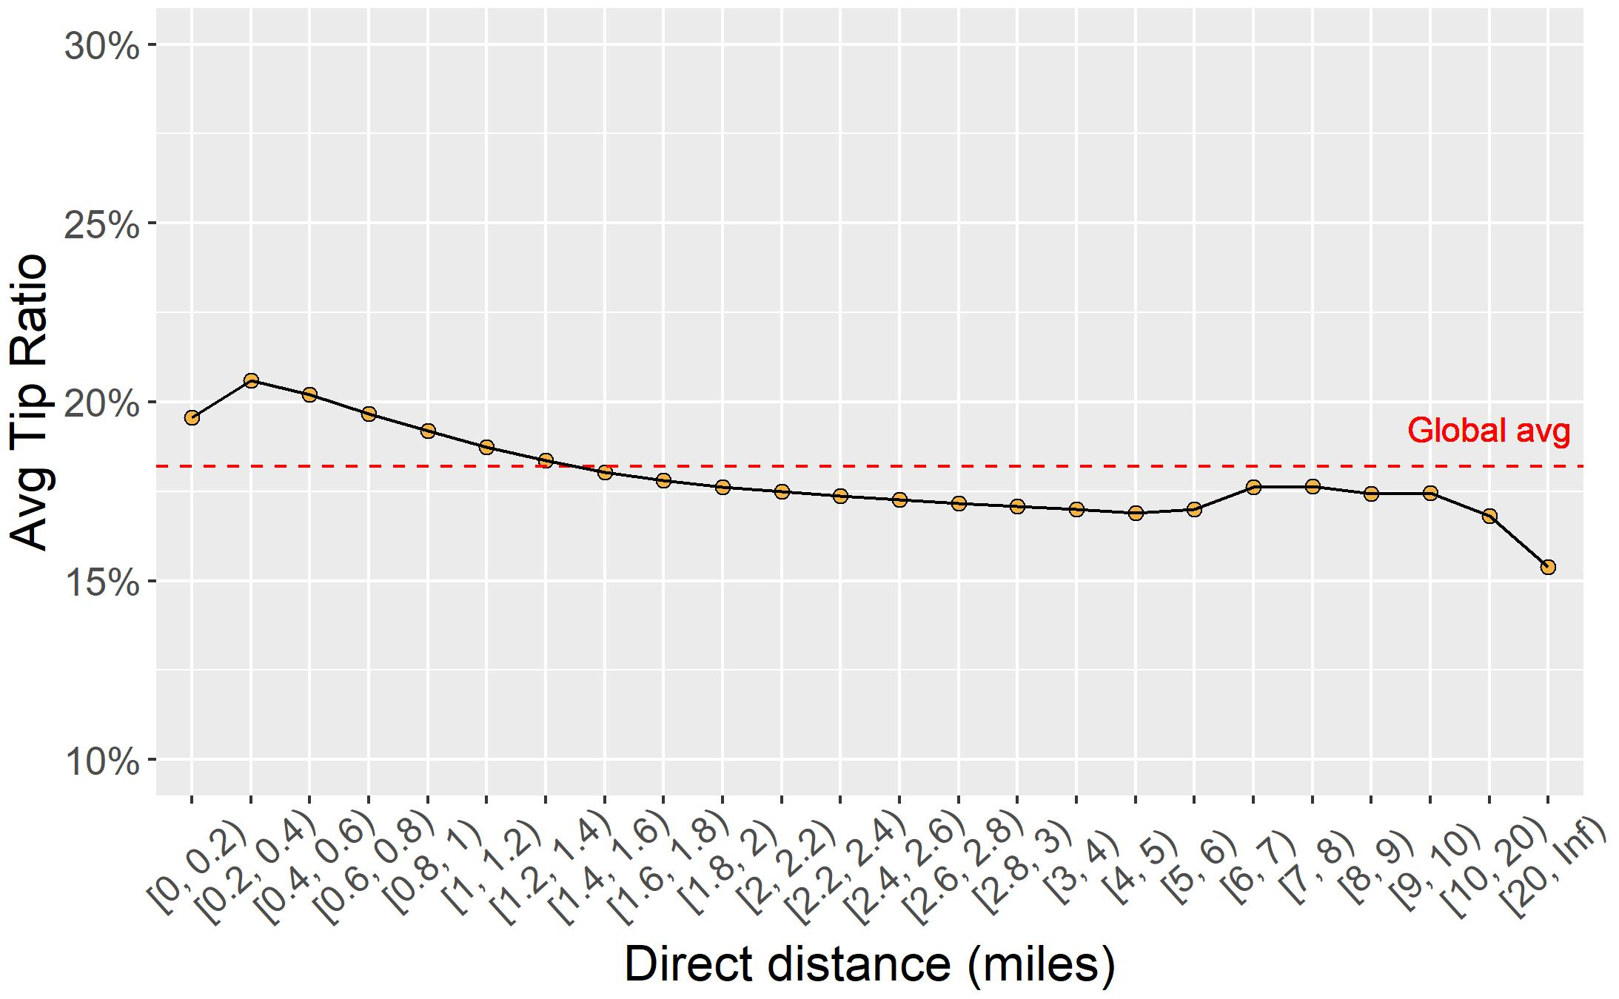

Slide 35
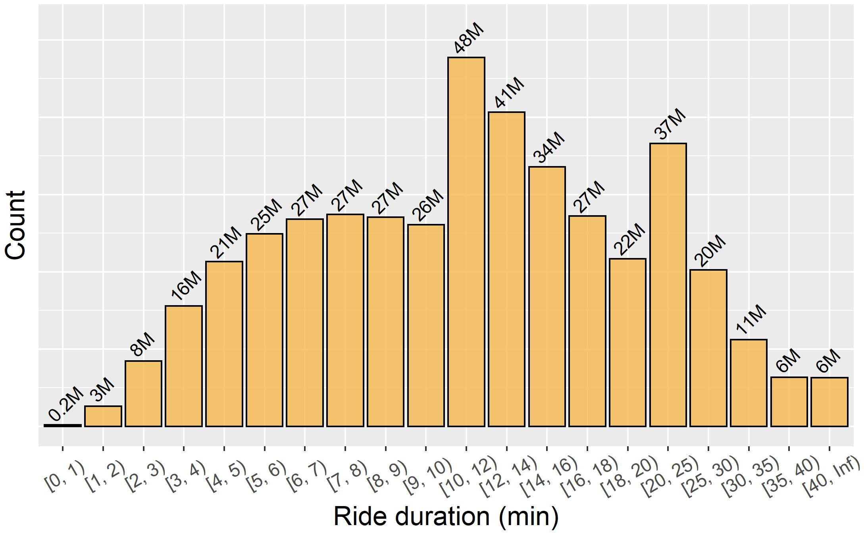
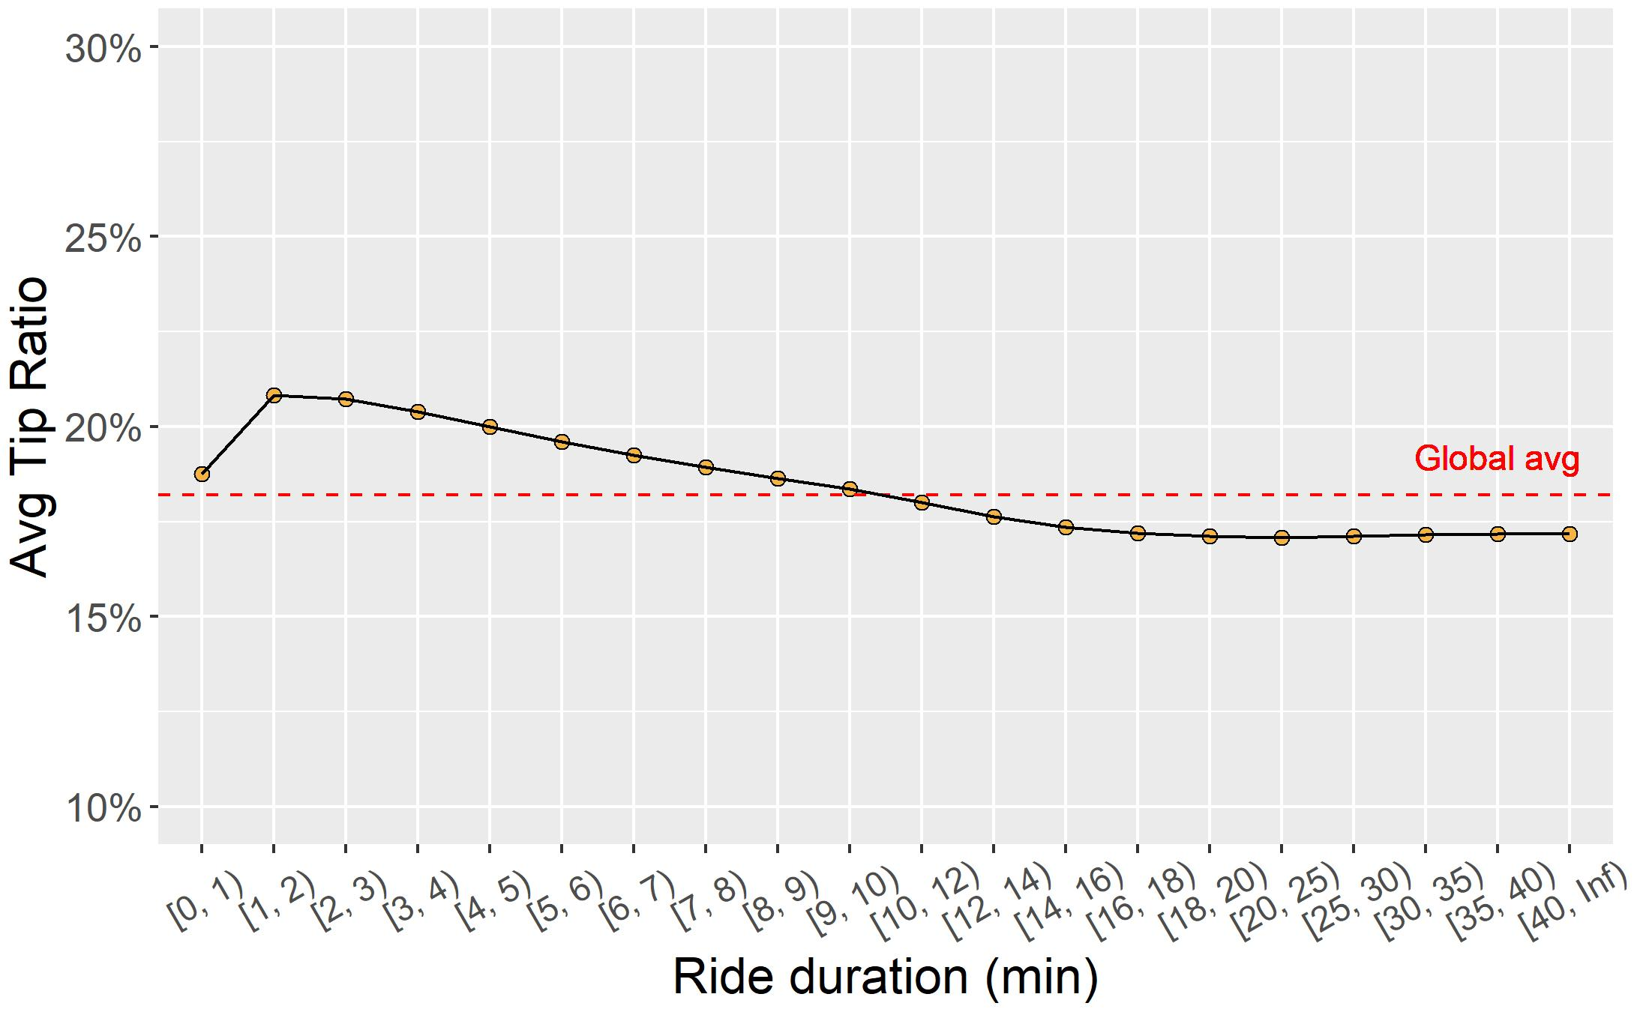
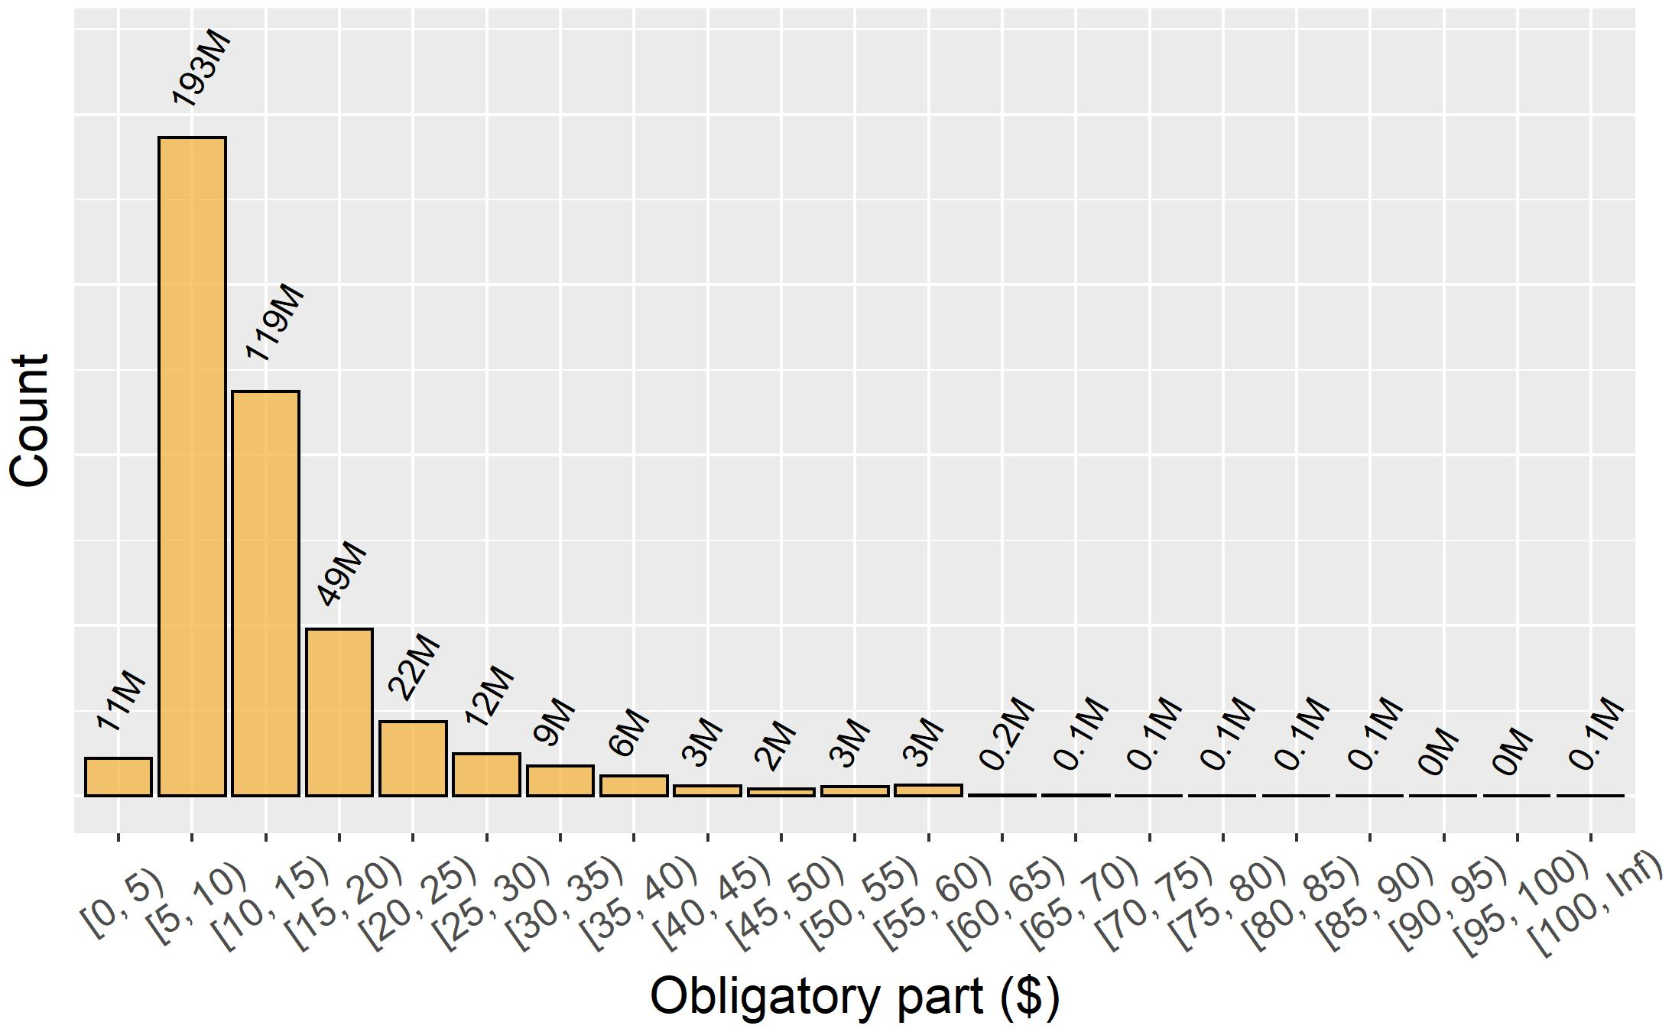
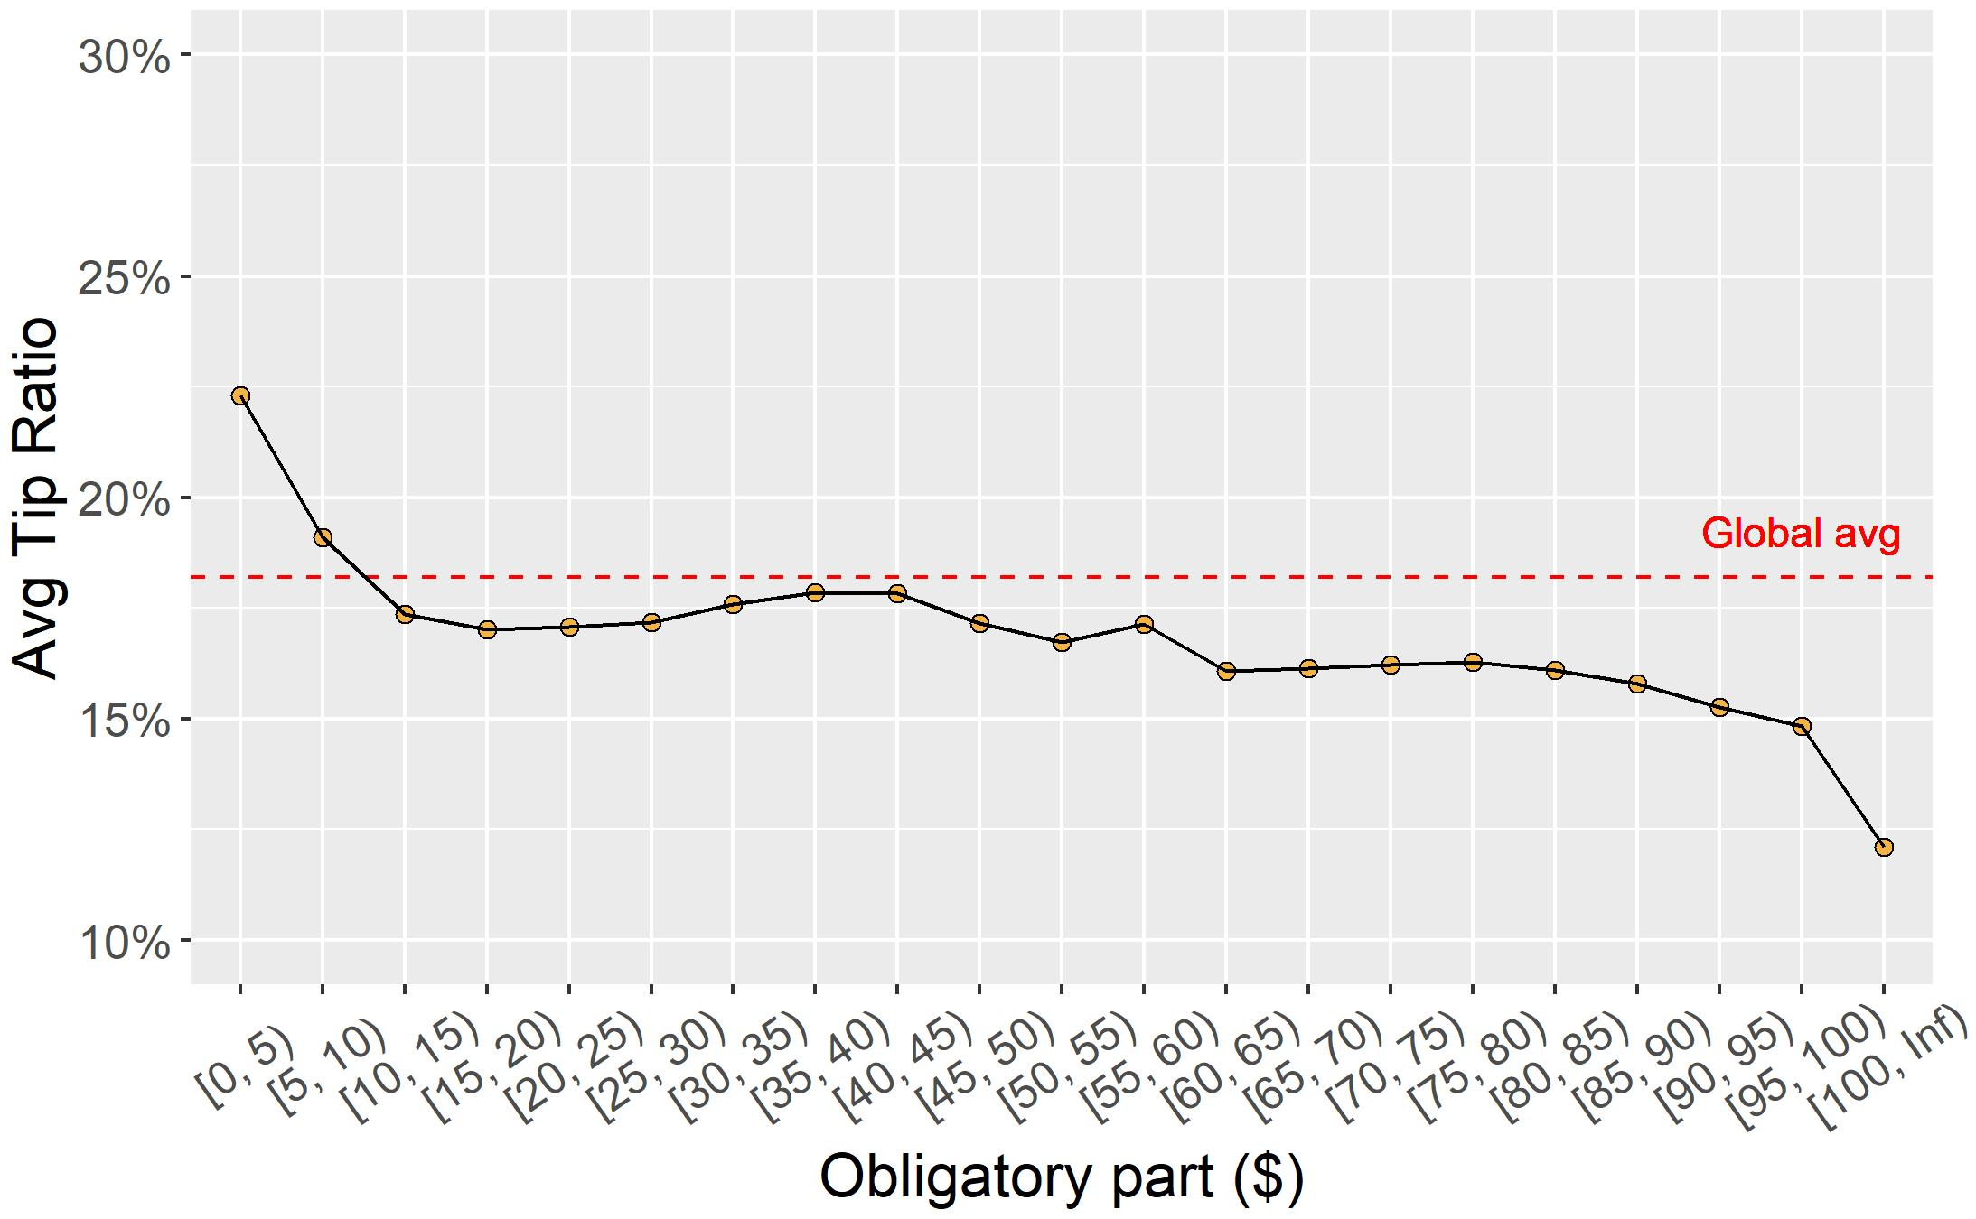

Slide 36
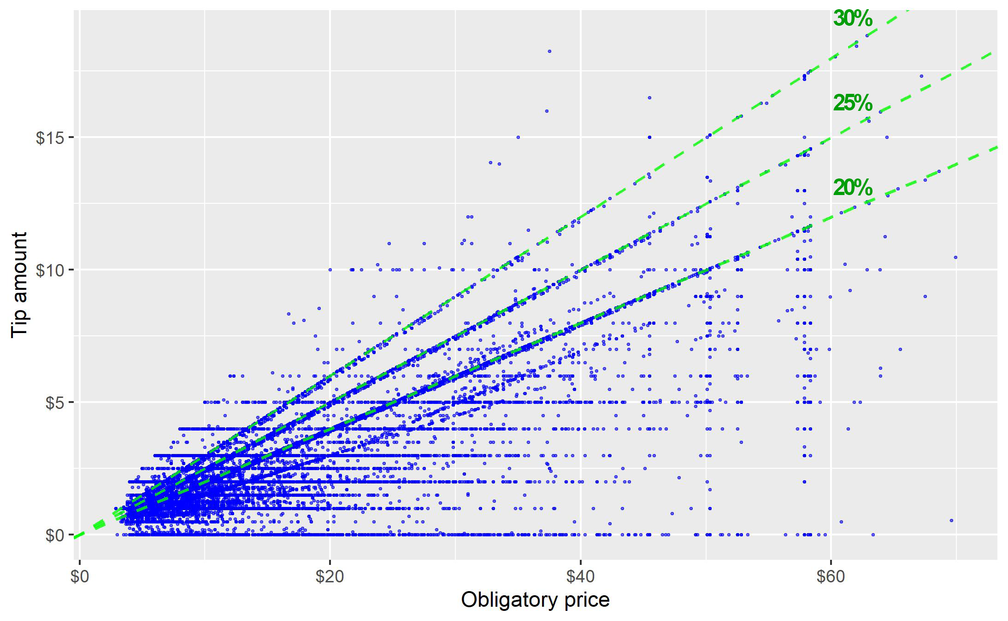
Obligatory part

Slide 37
Performance-related features

Slide 38
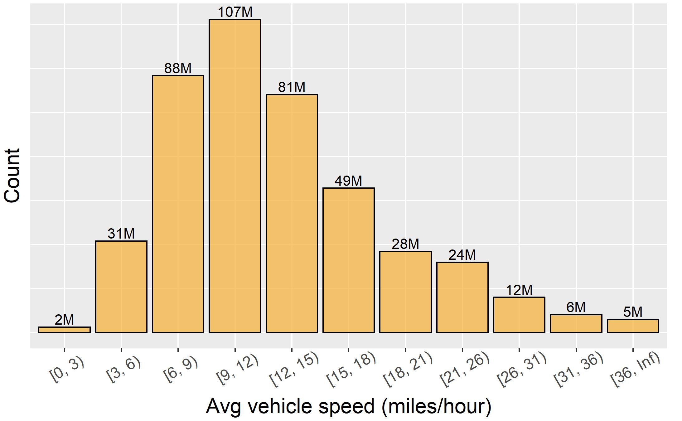
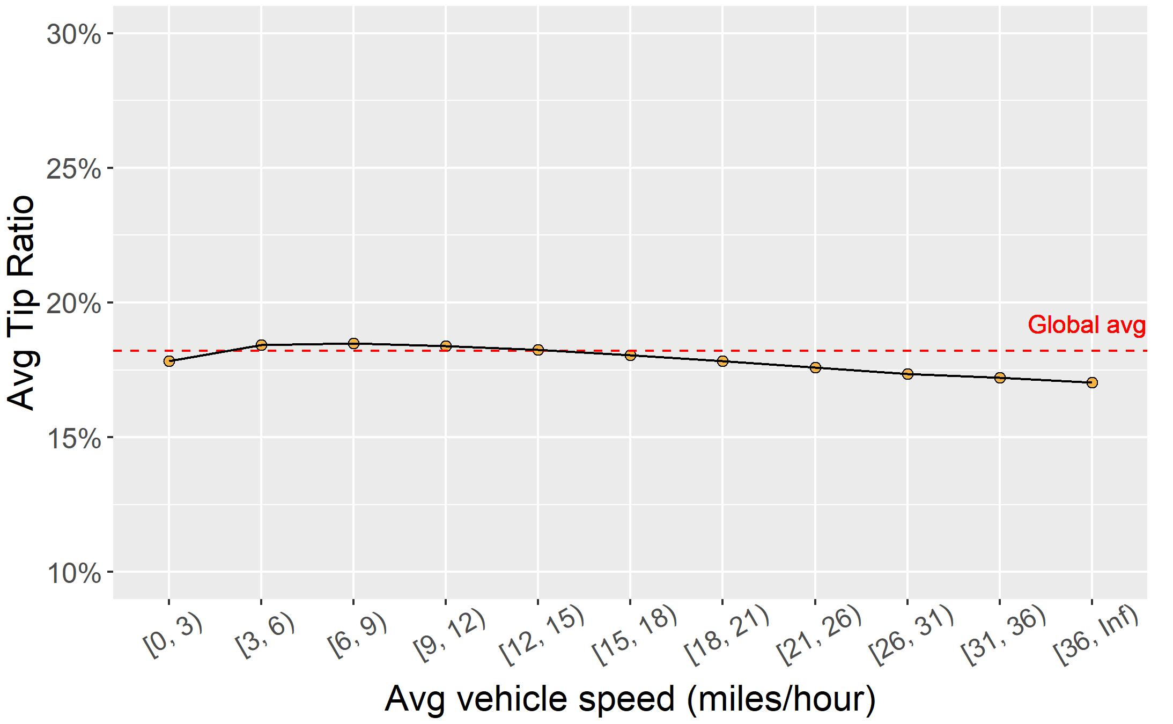
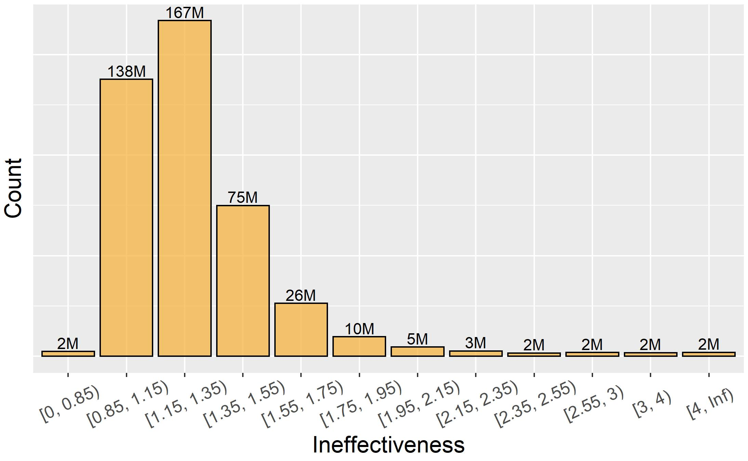
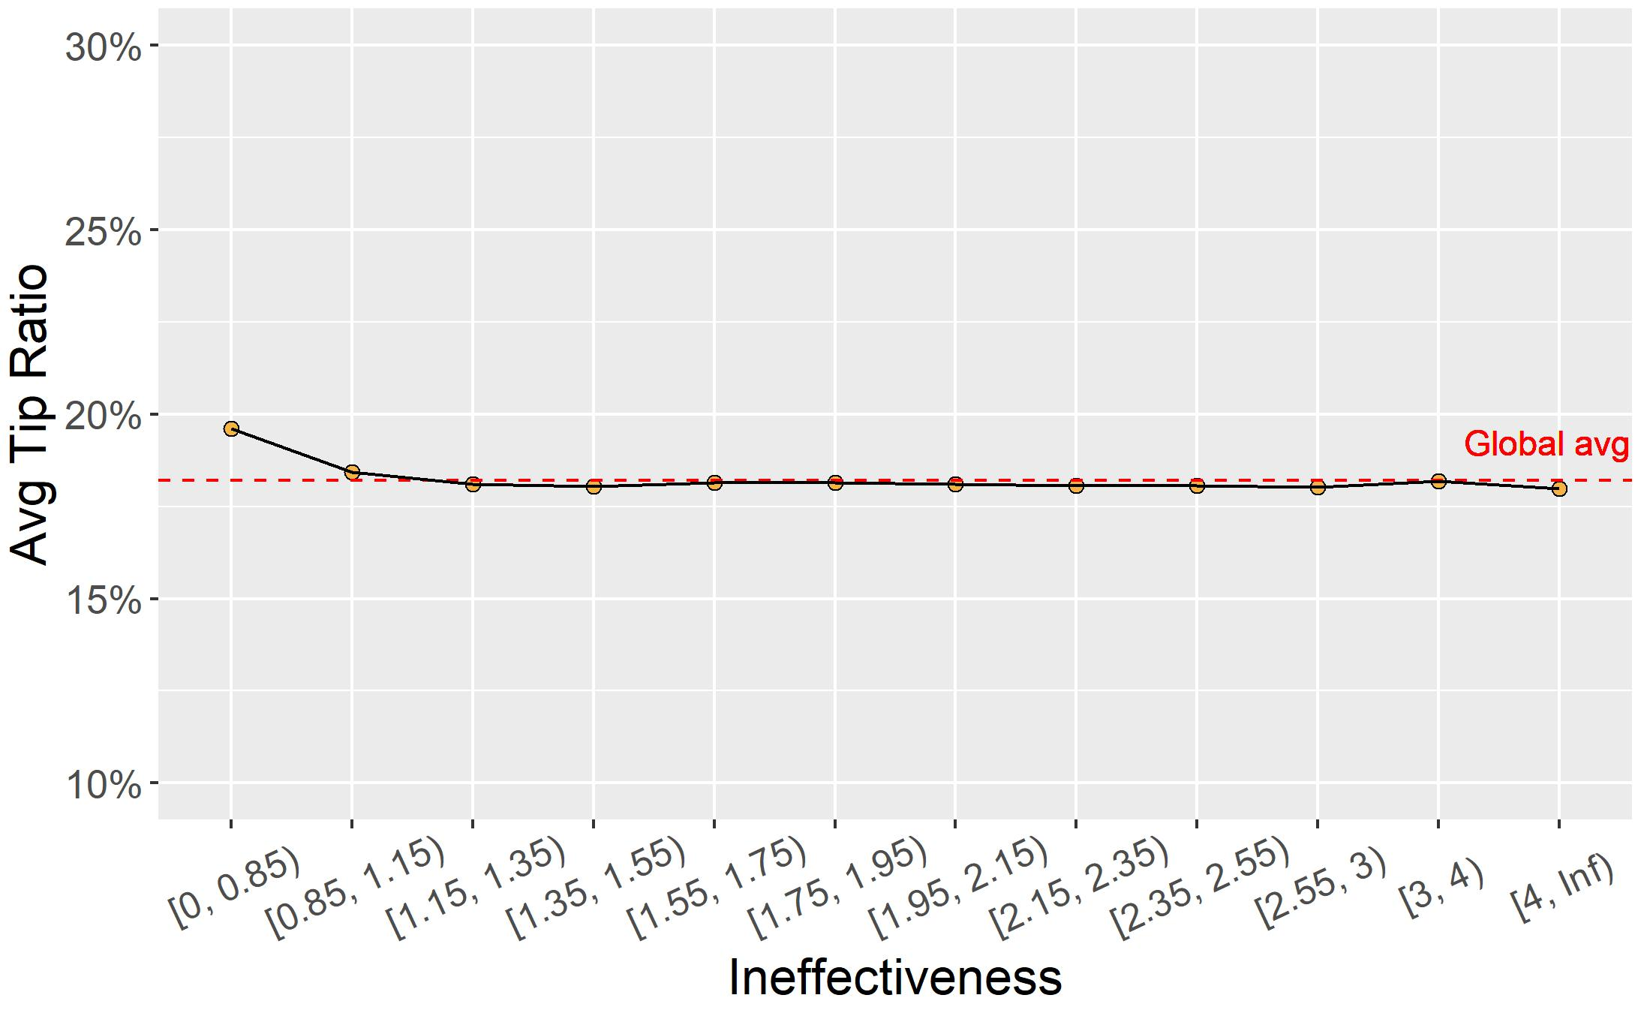

Slide 39
Time-related features

Slide 40
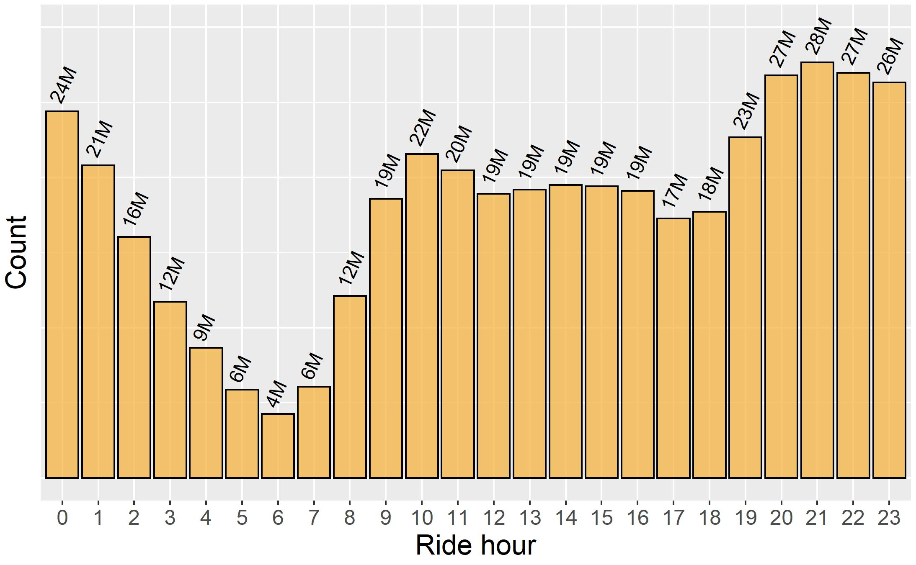
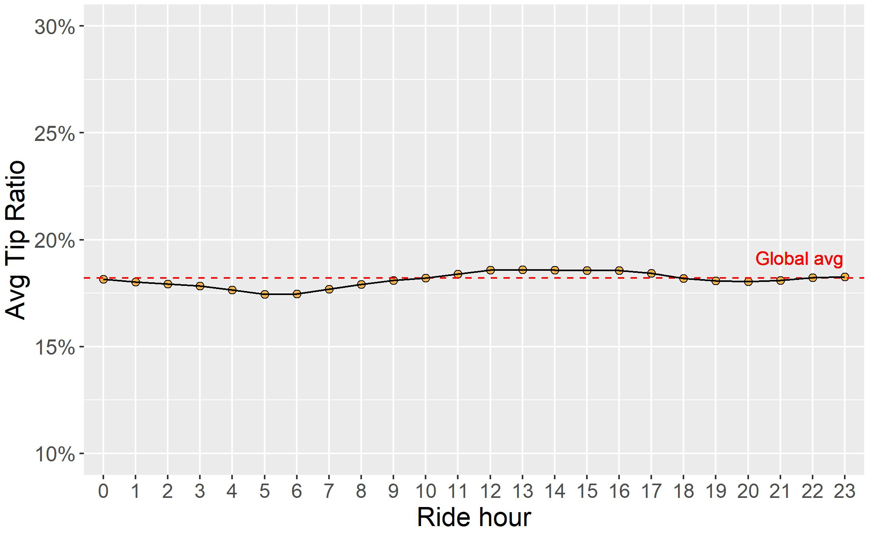
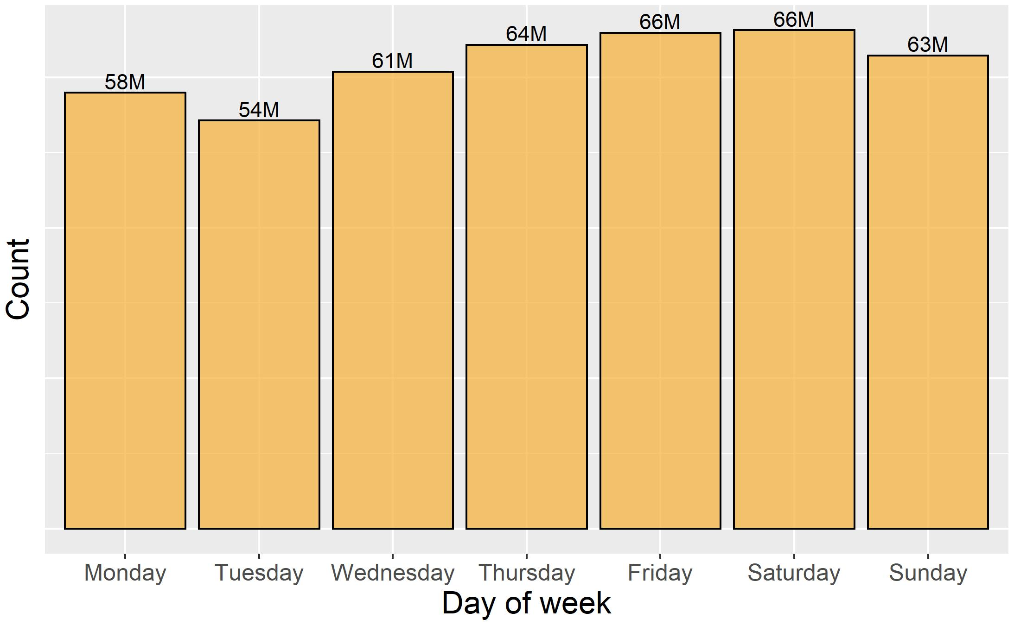
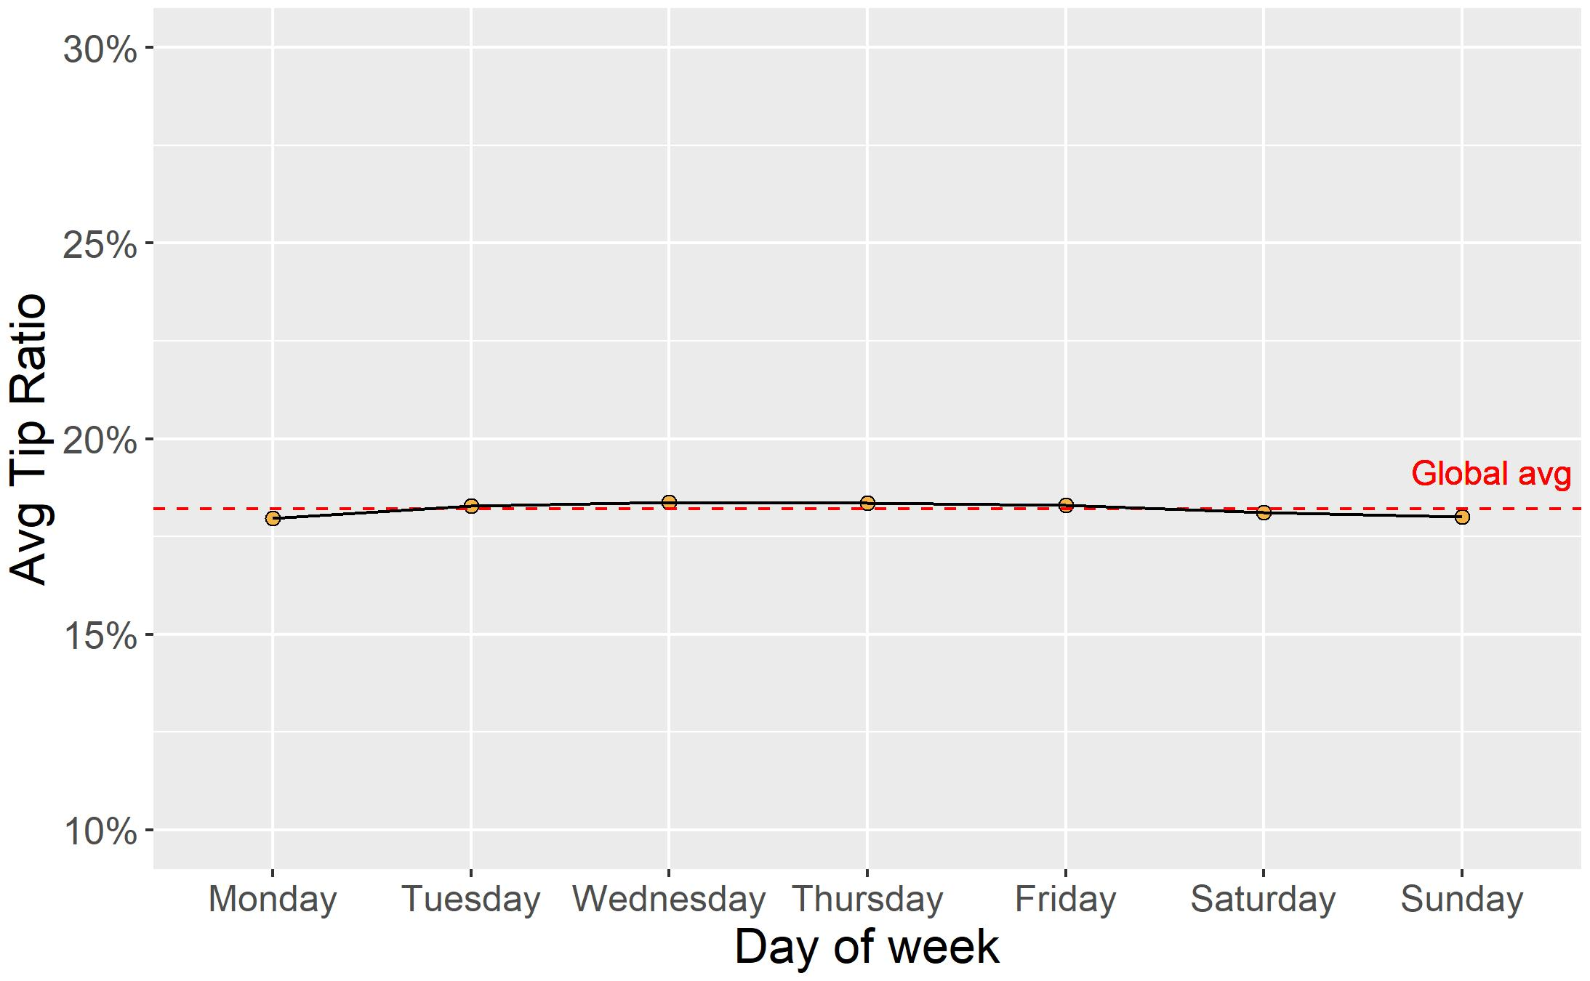

Slide 41
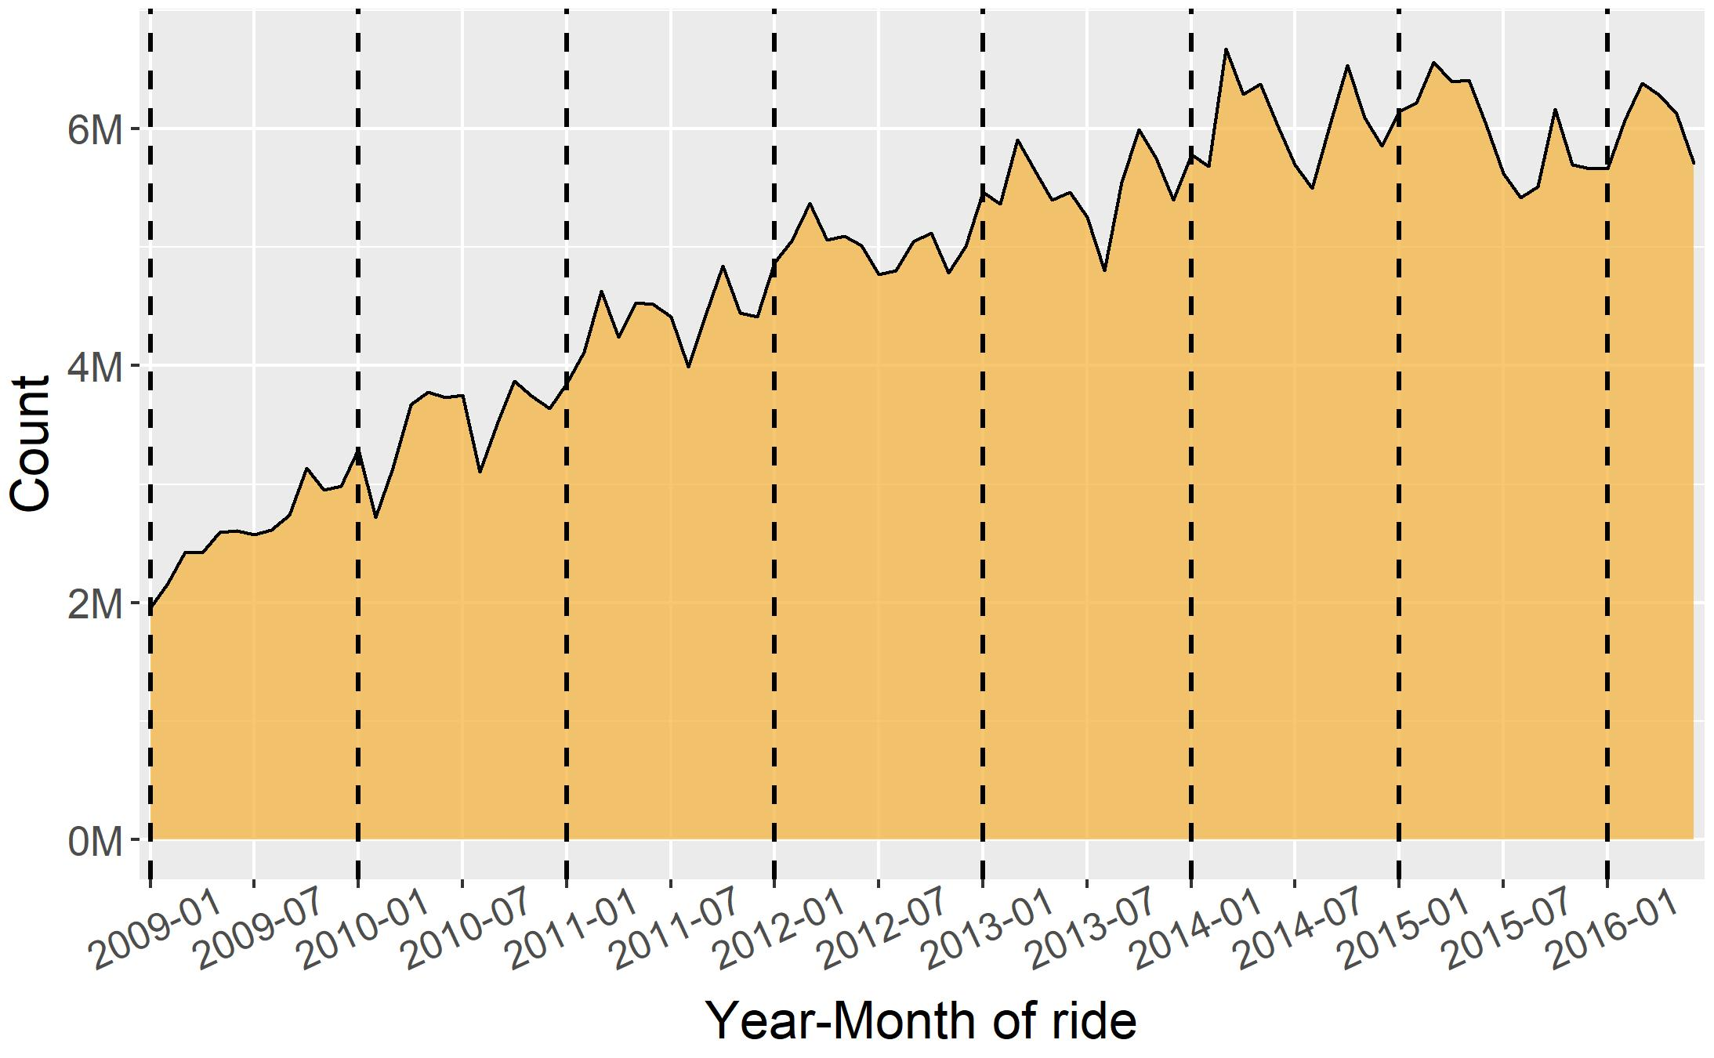
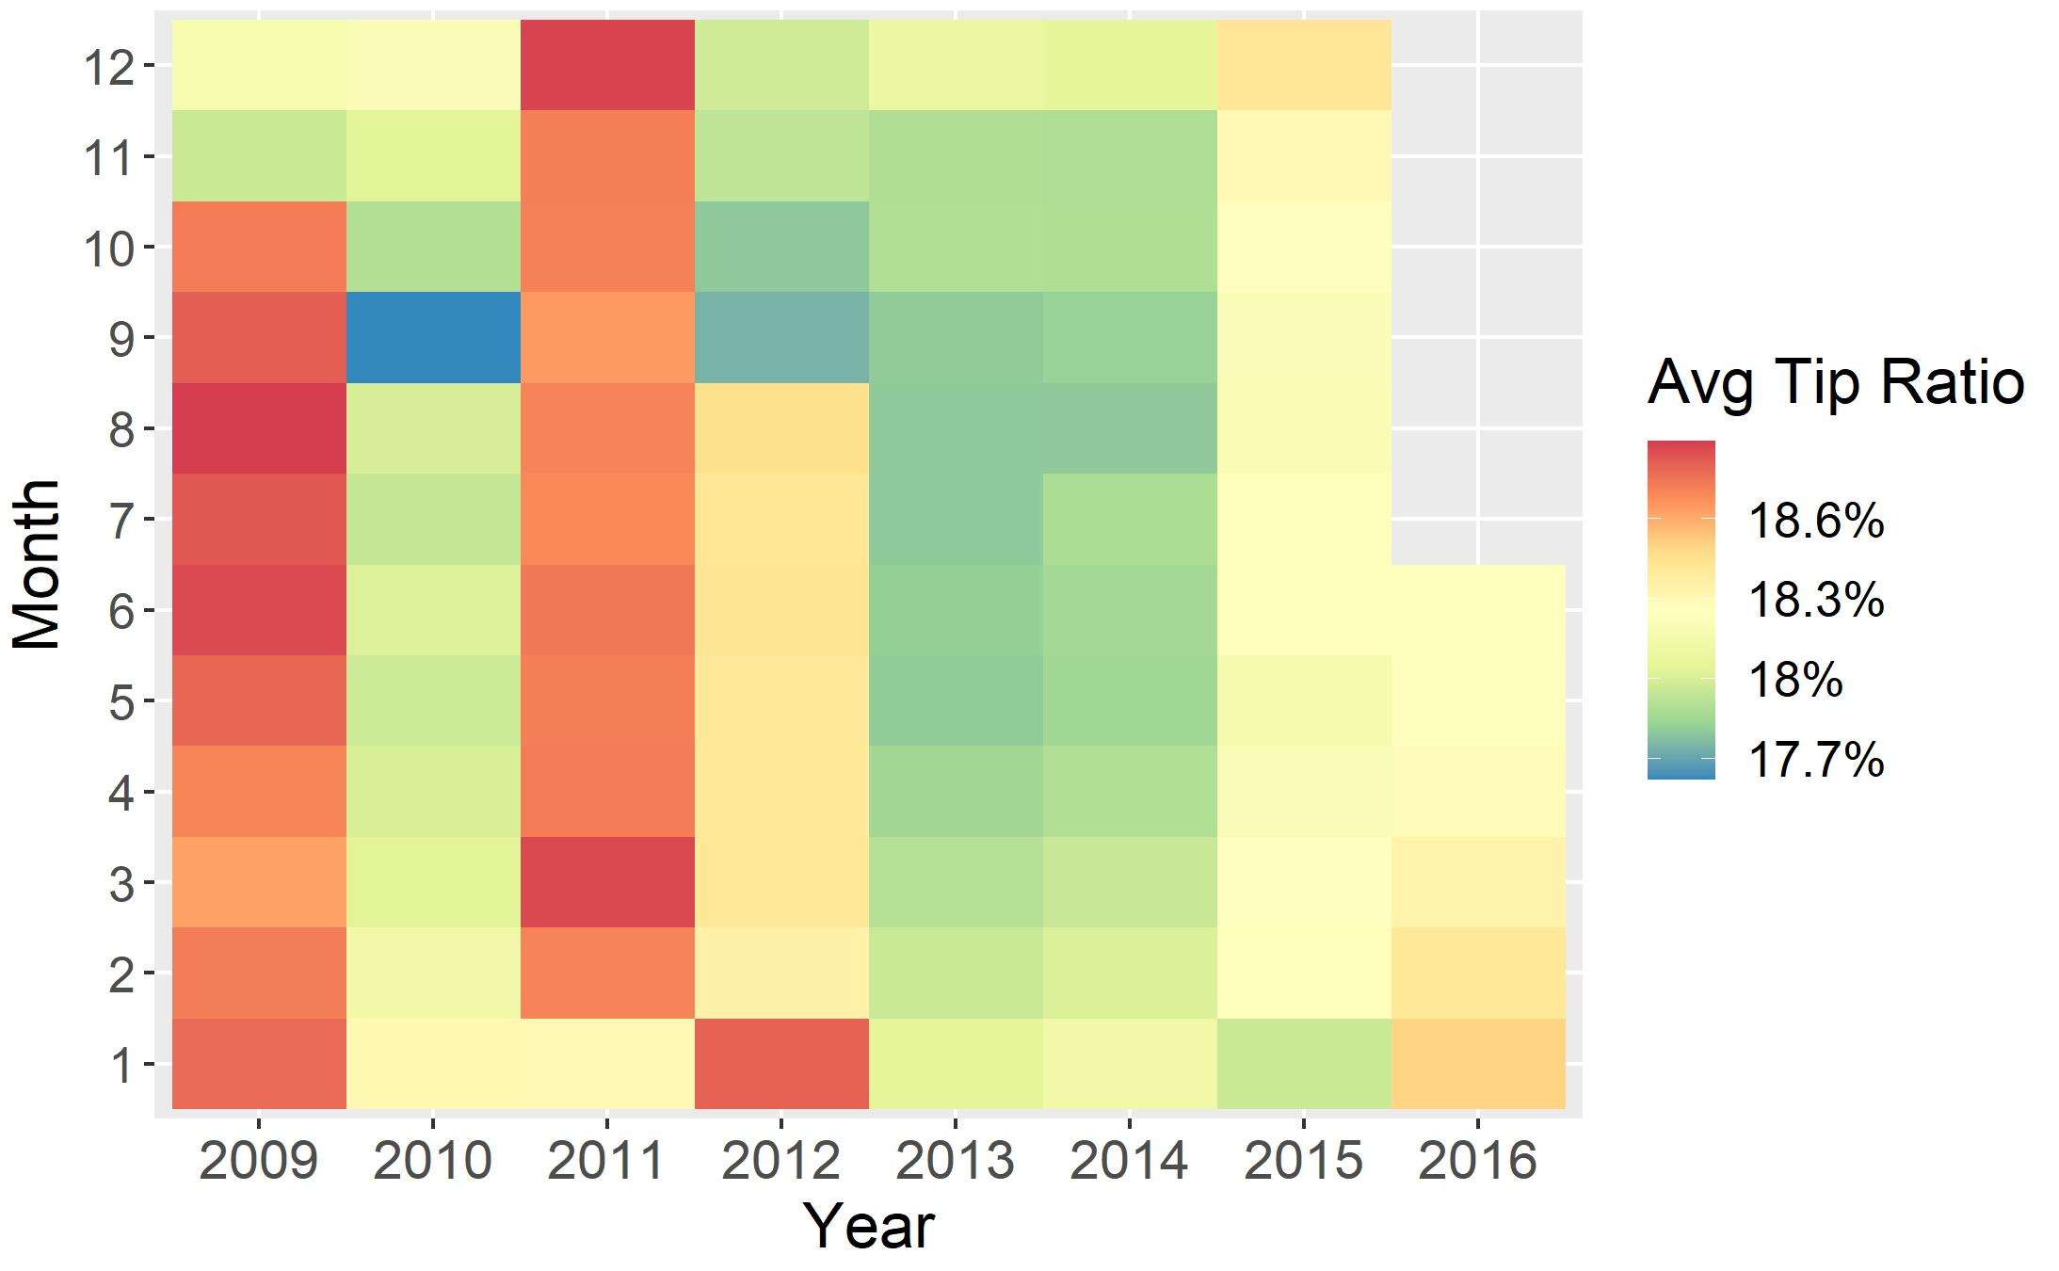
Month and year

Slide 42
Location-related features

Slide 43
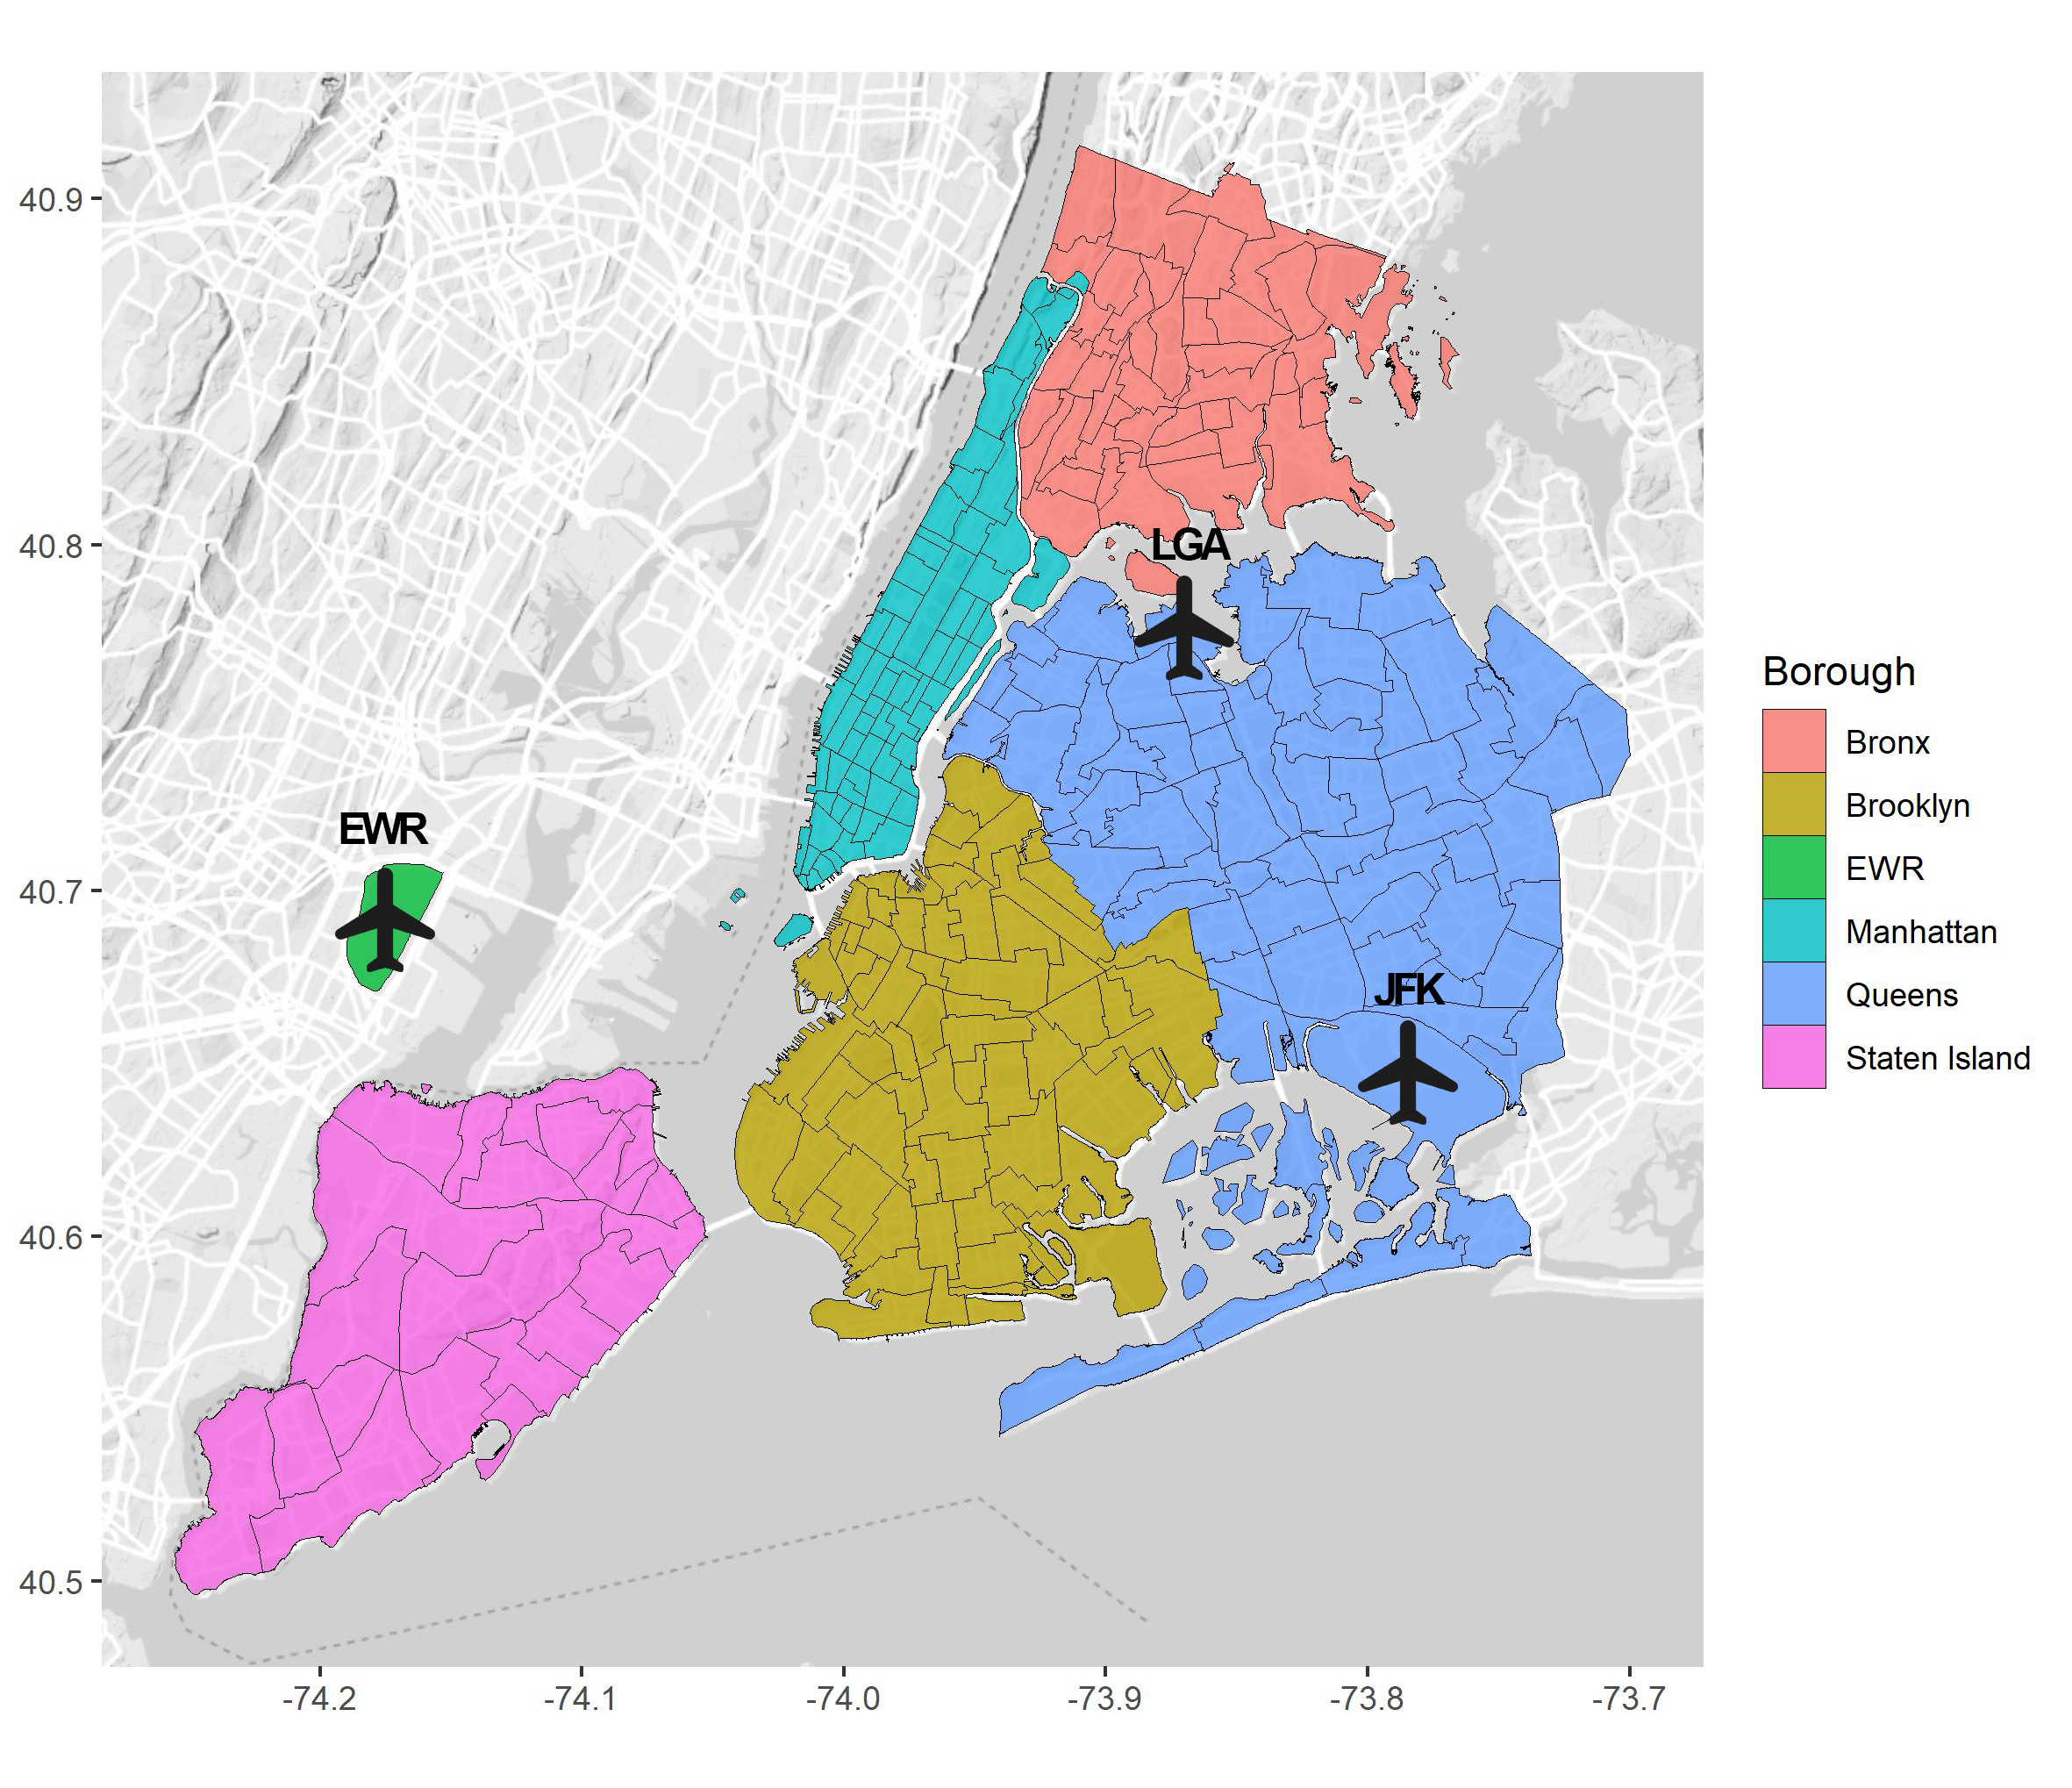
Map of New York City

Slide 44
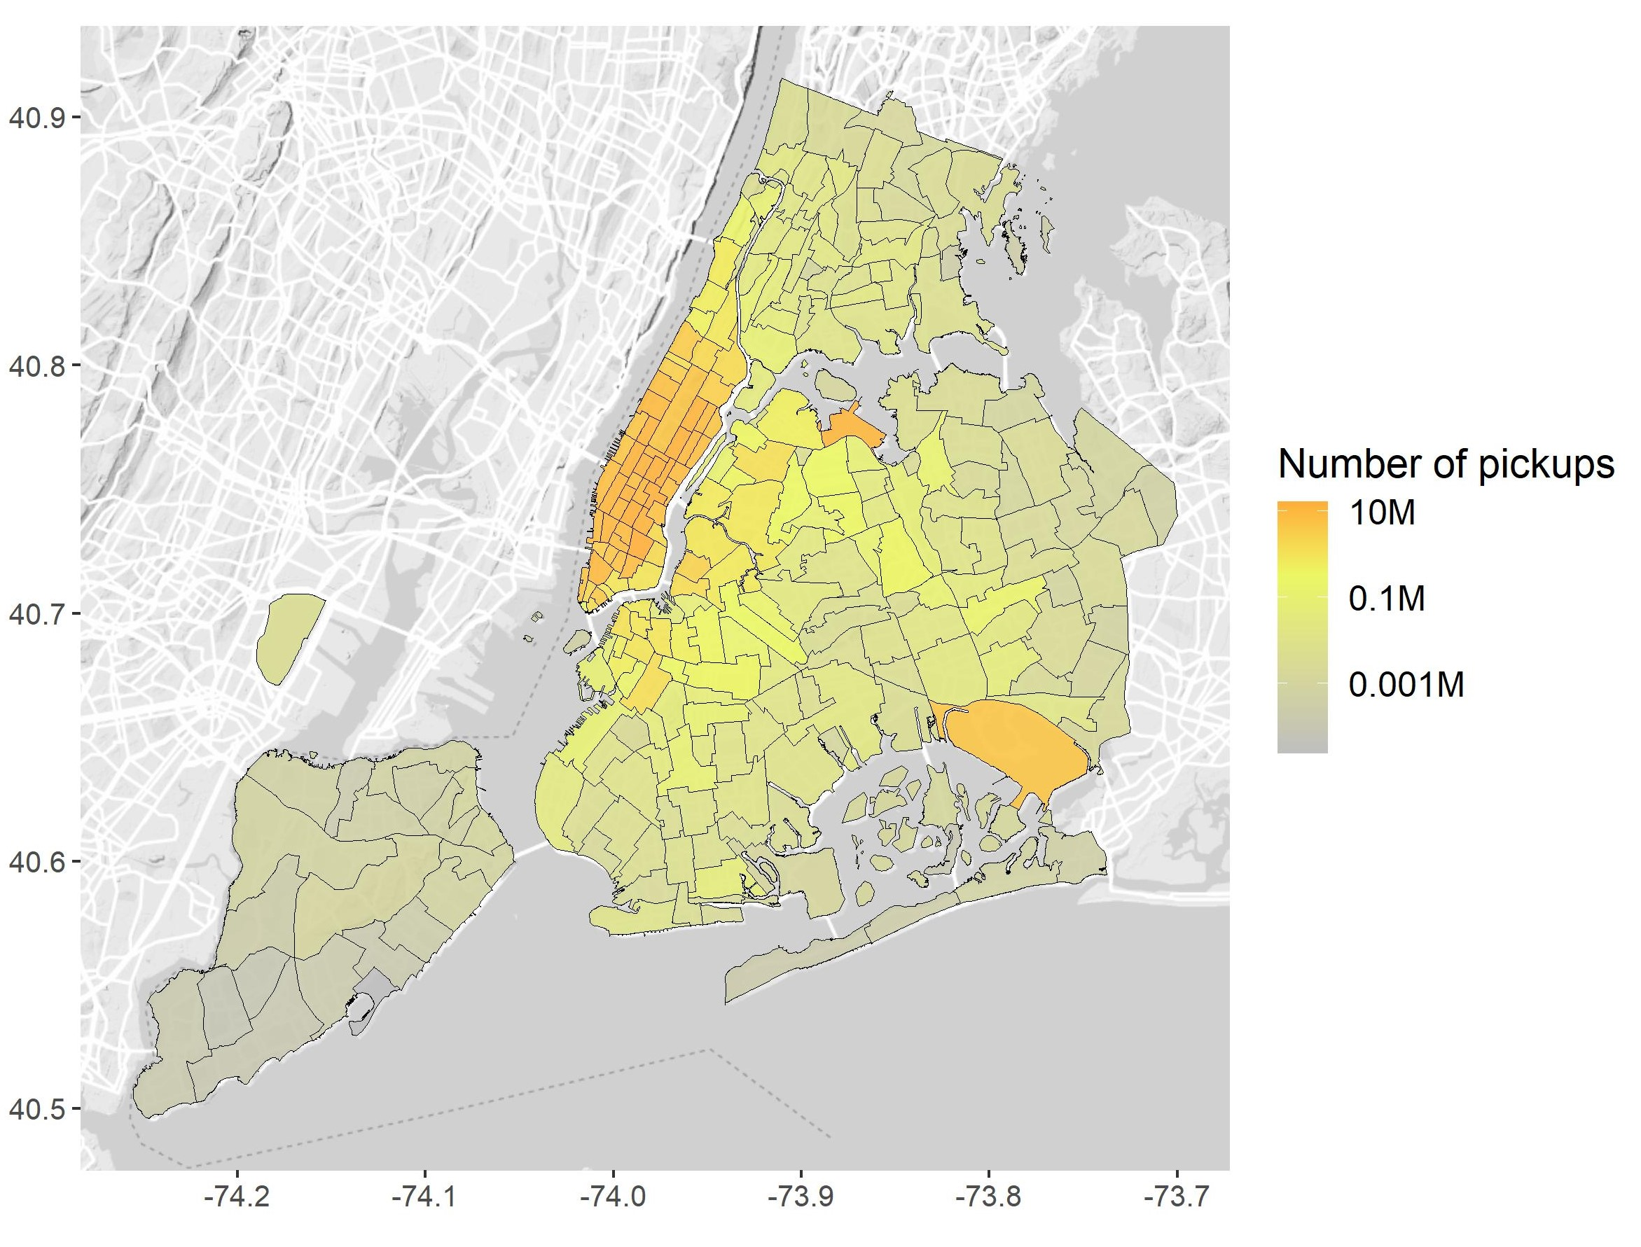
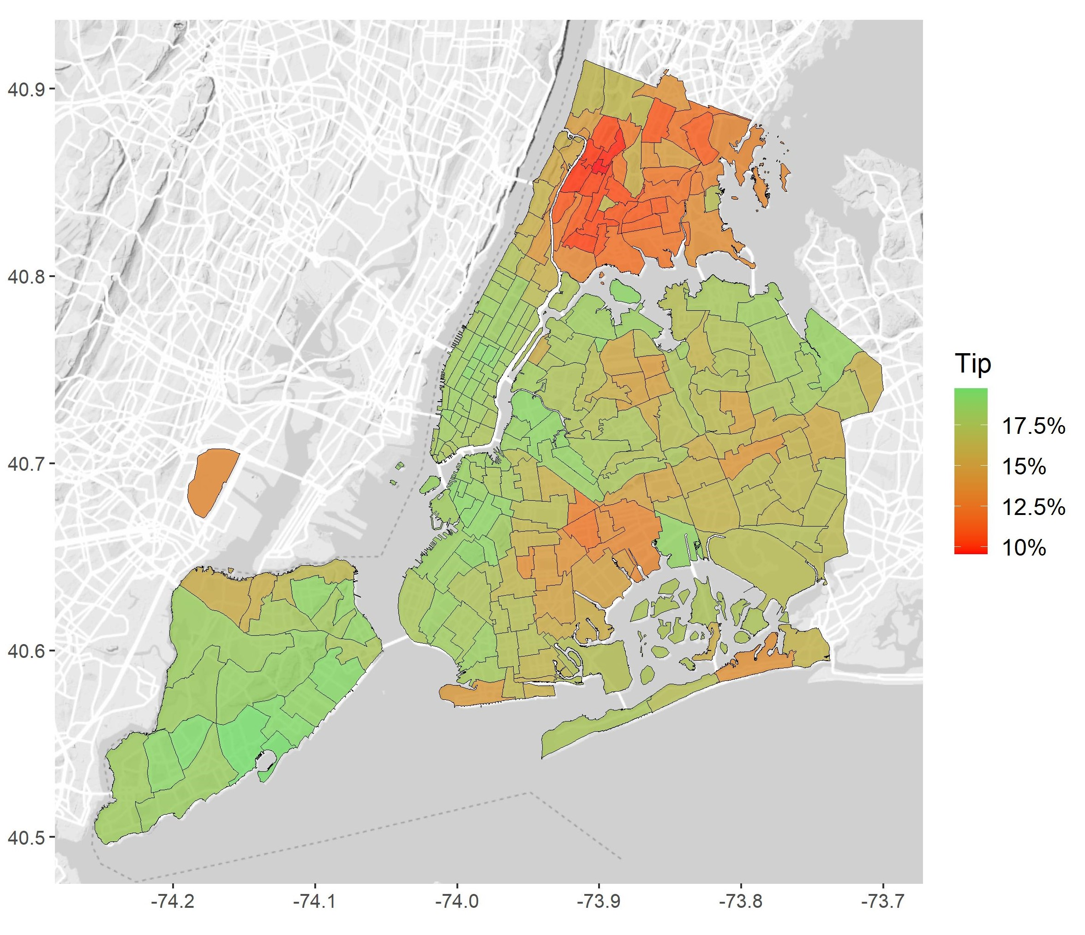
Pickup zone

Slide 45
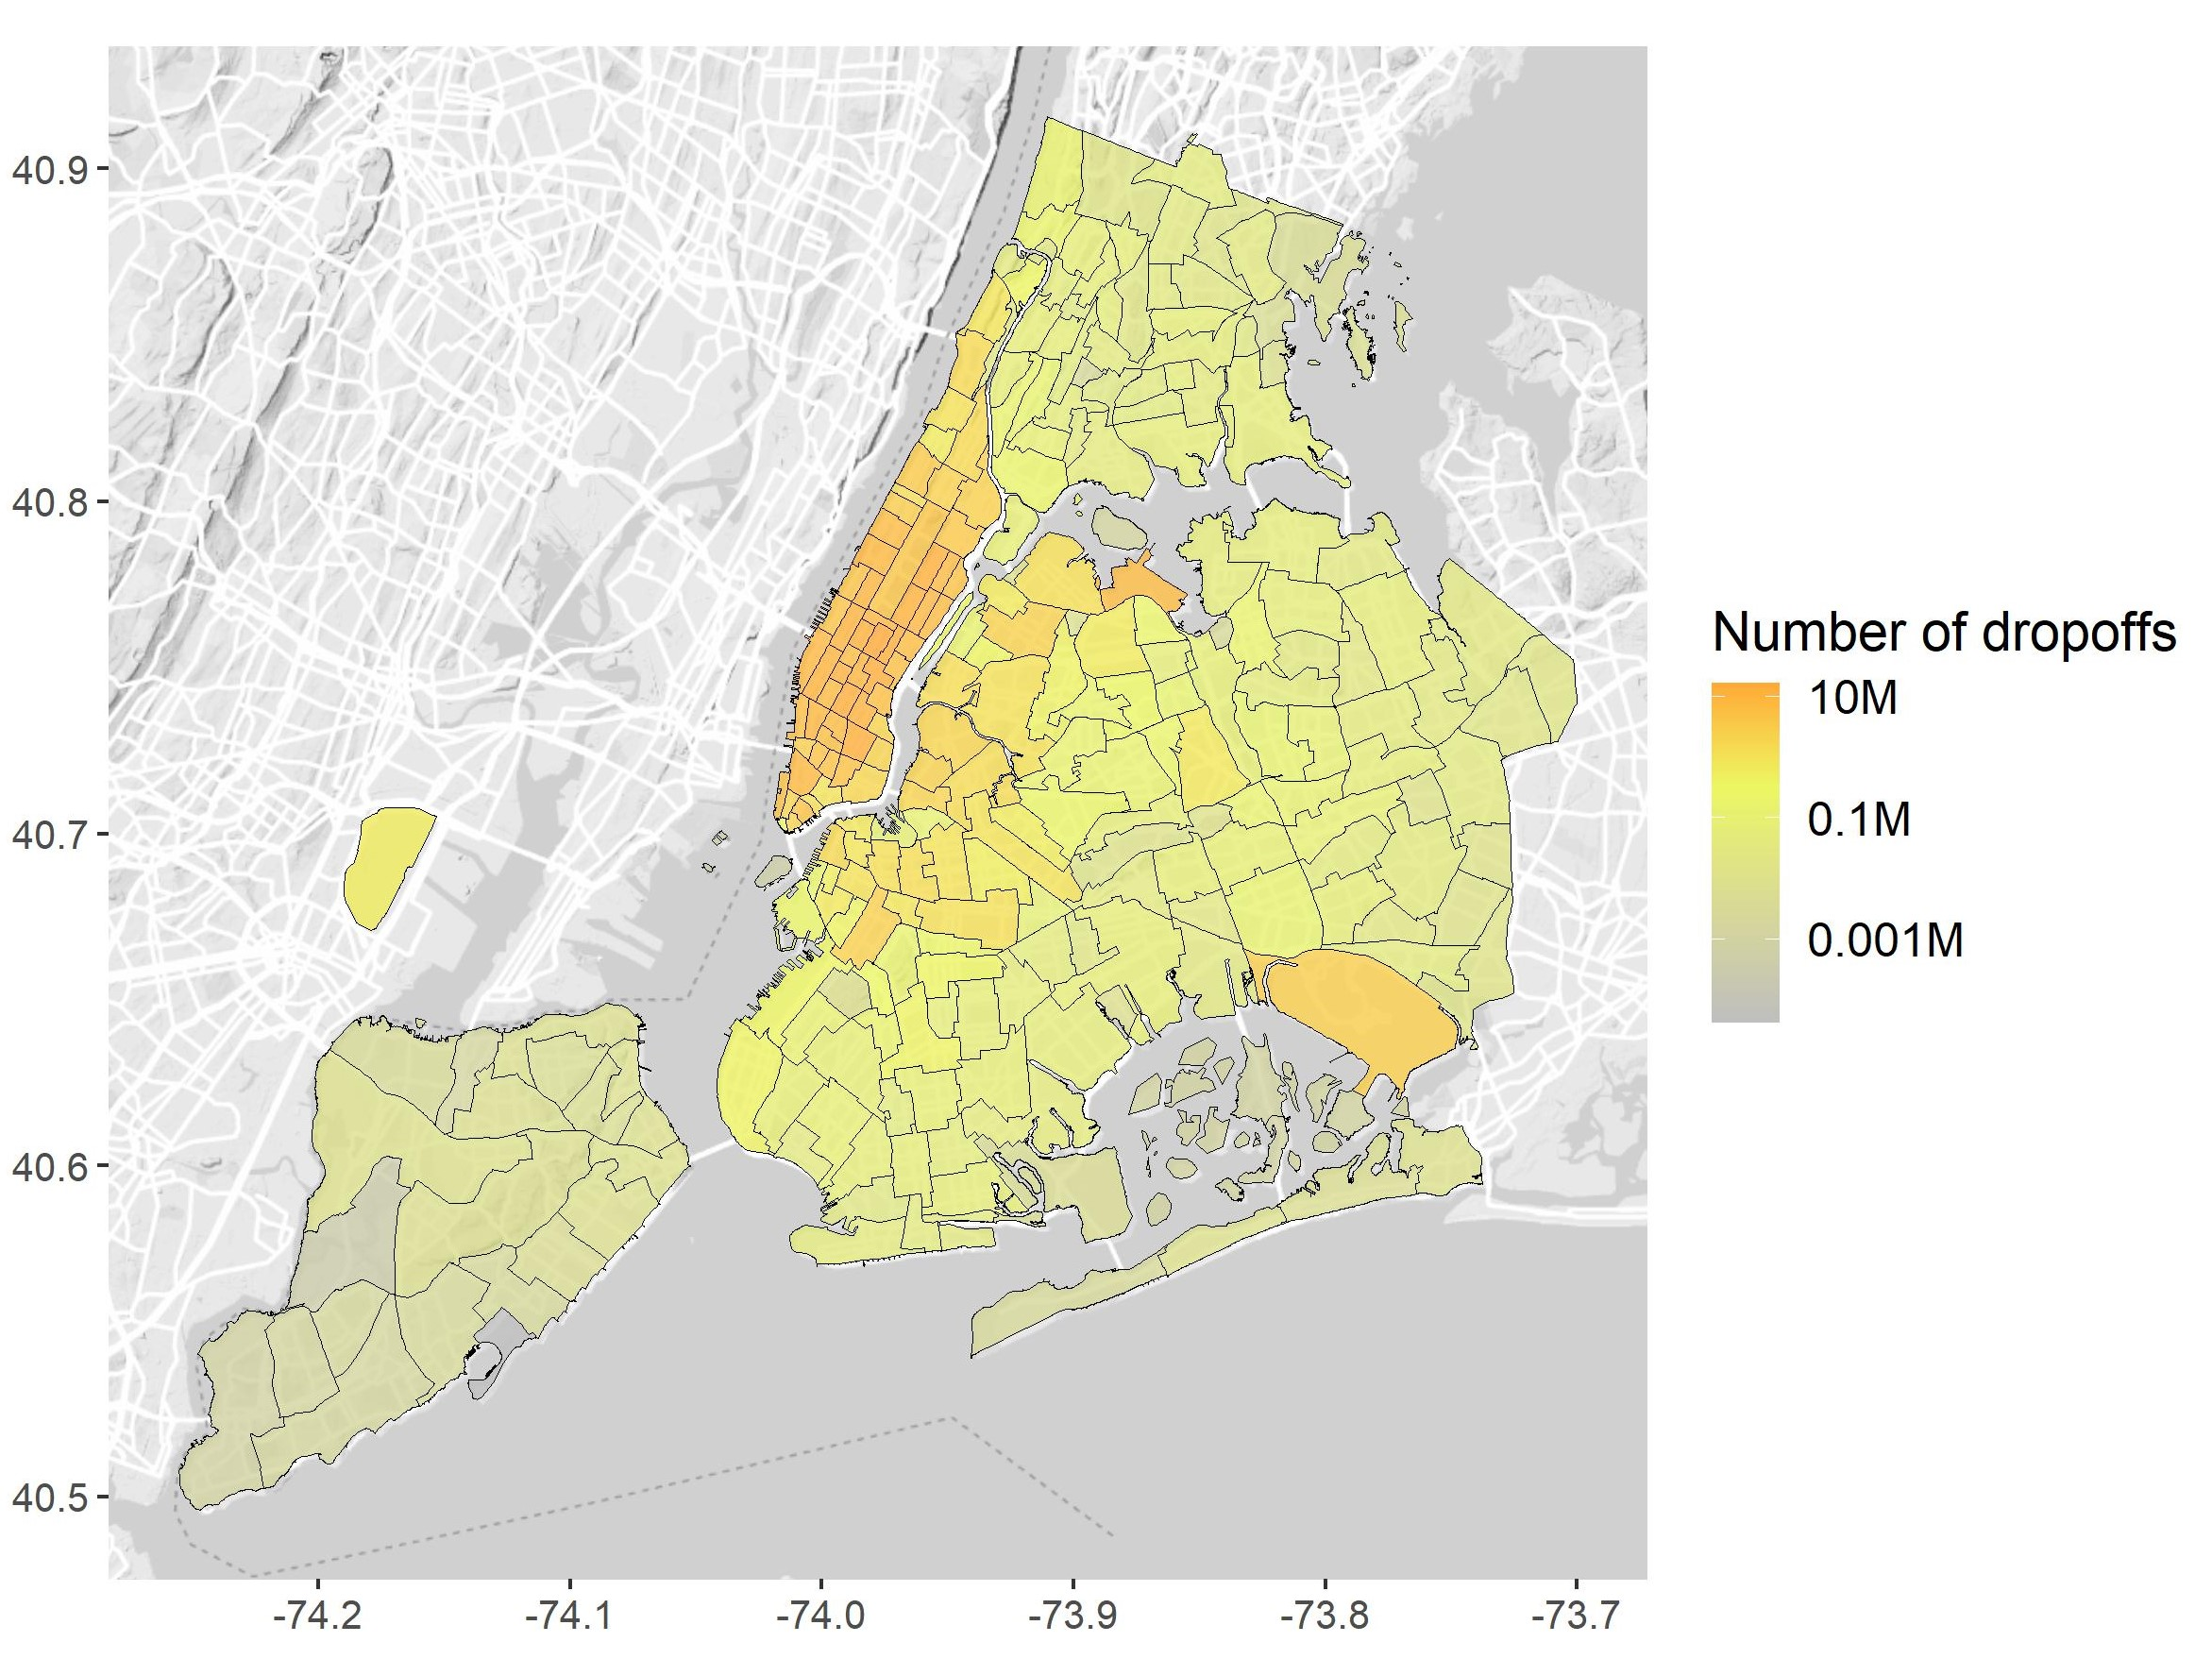
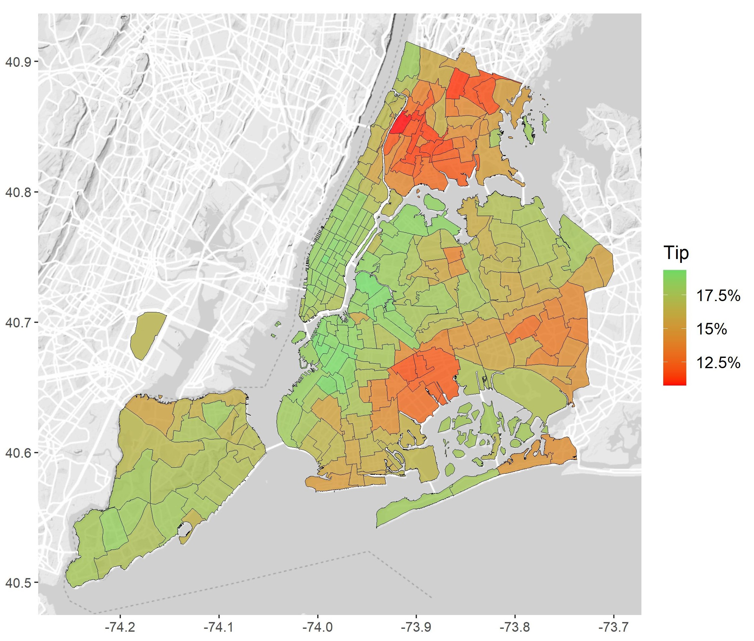
Dropoff zone

Slide 46
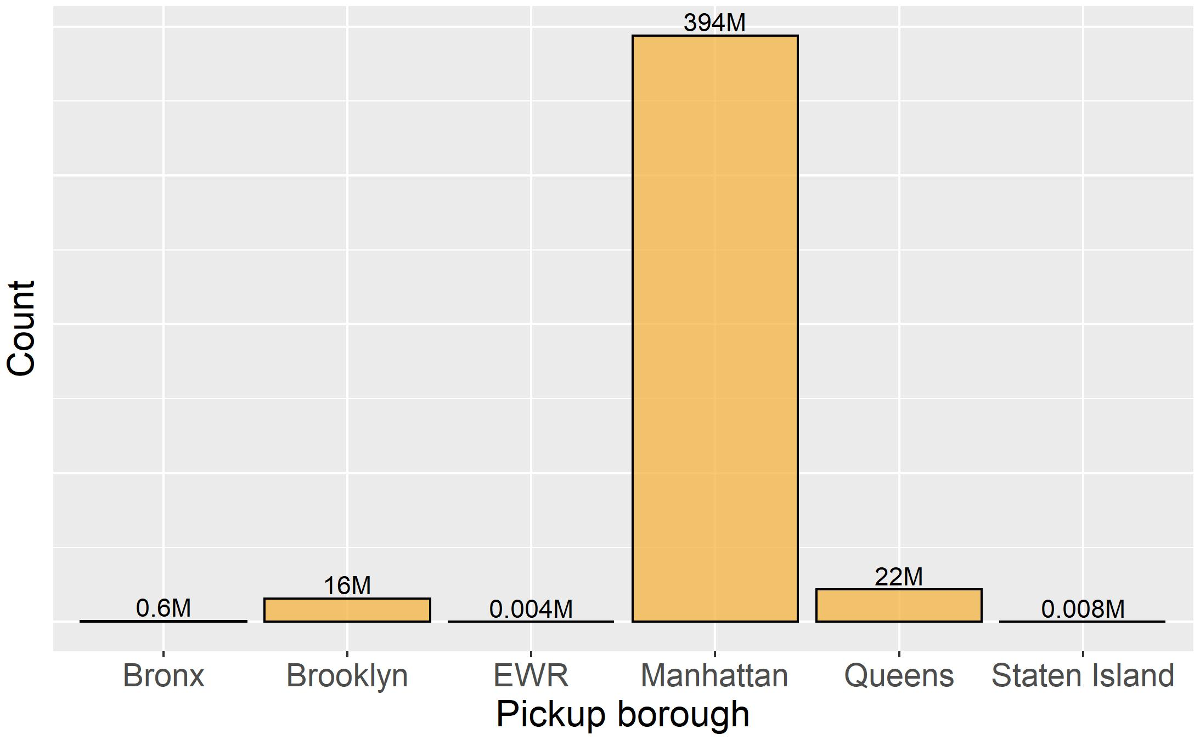
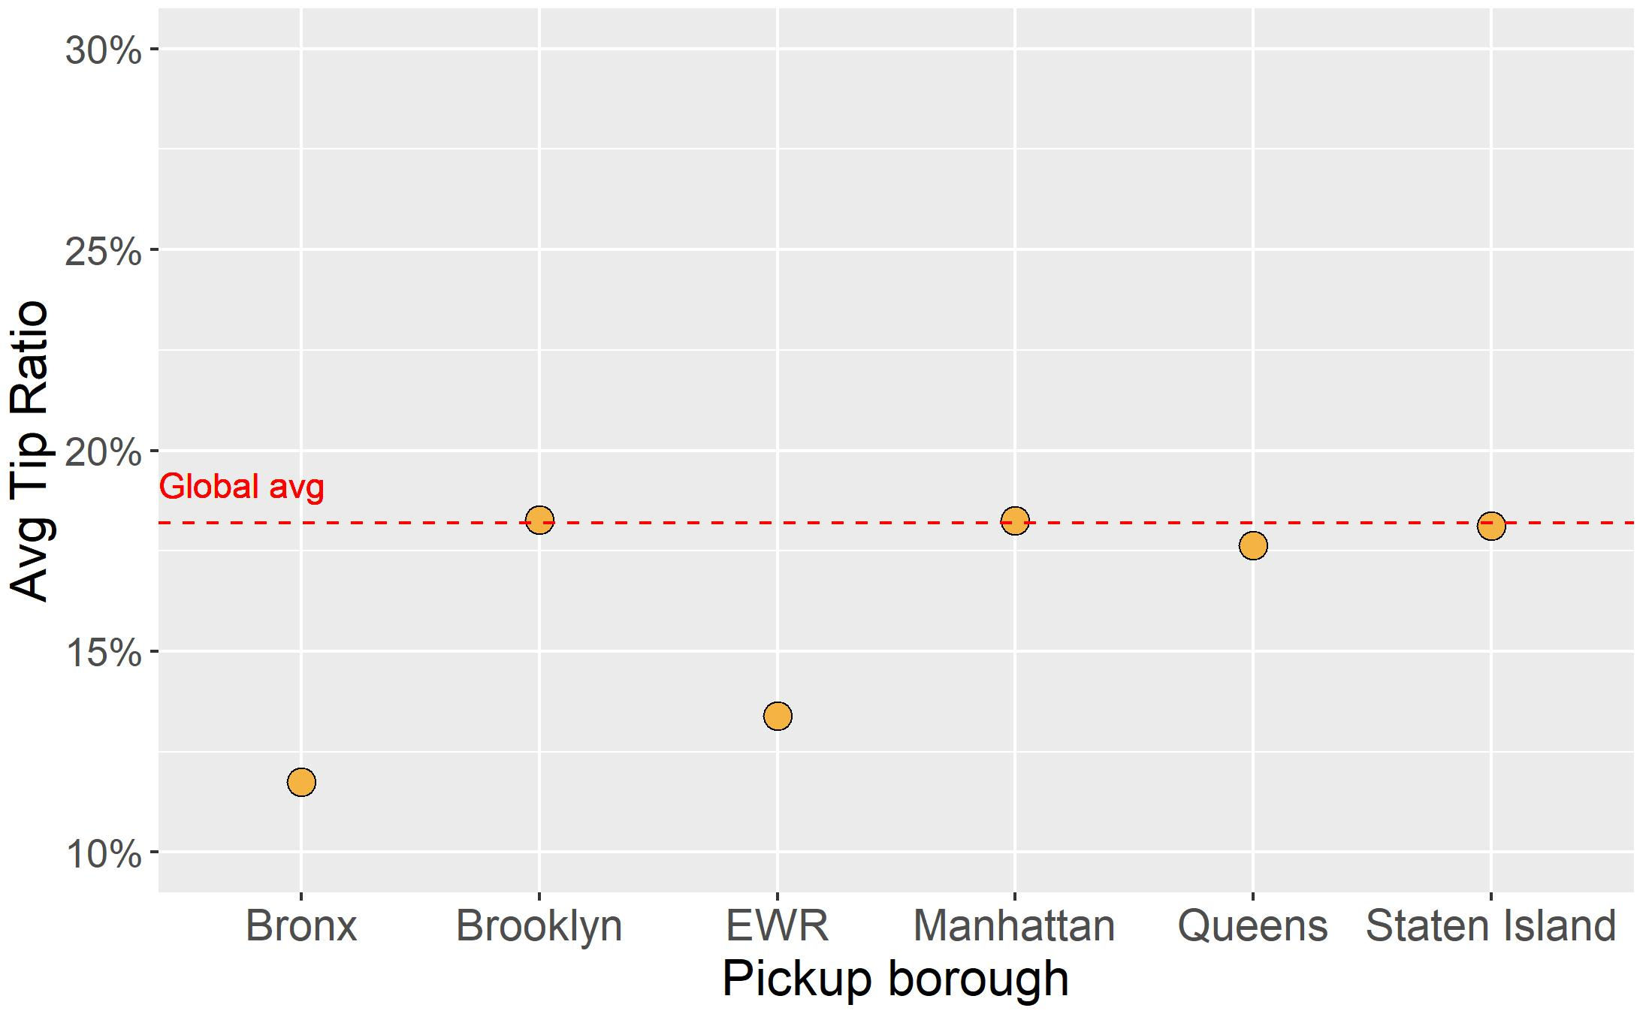
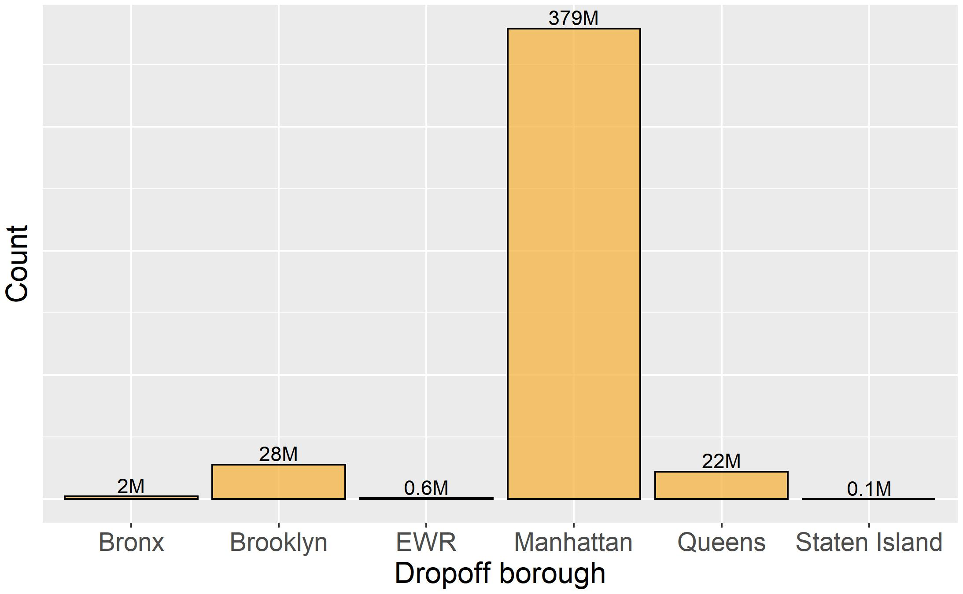
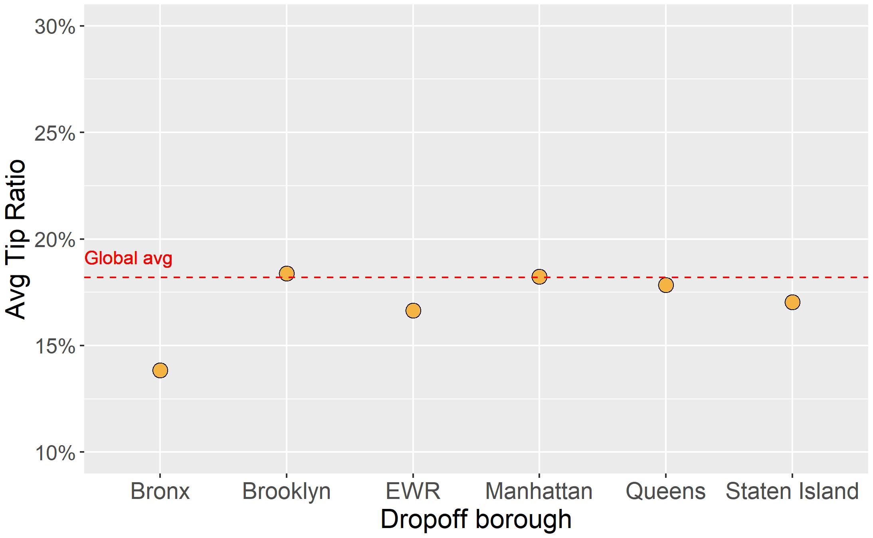

Slide 47
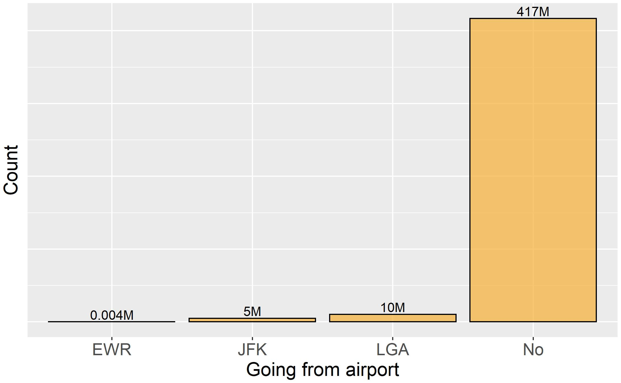
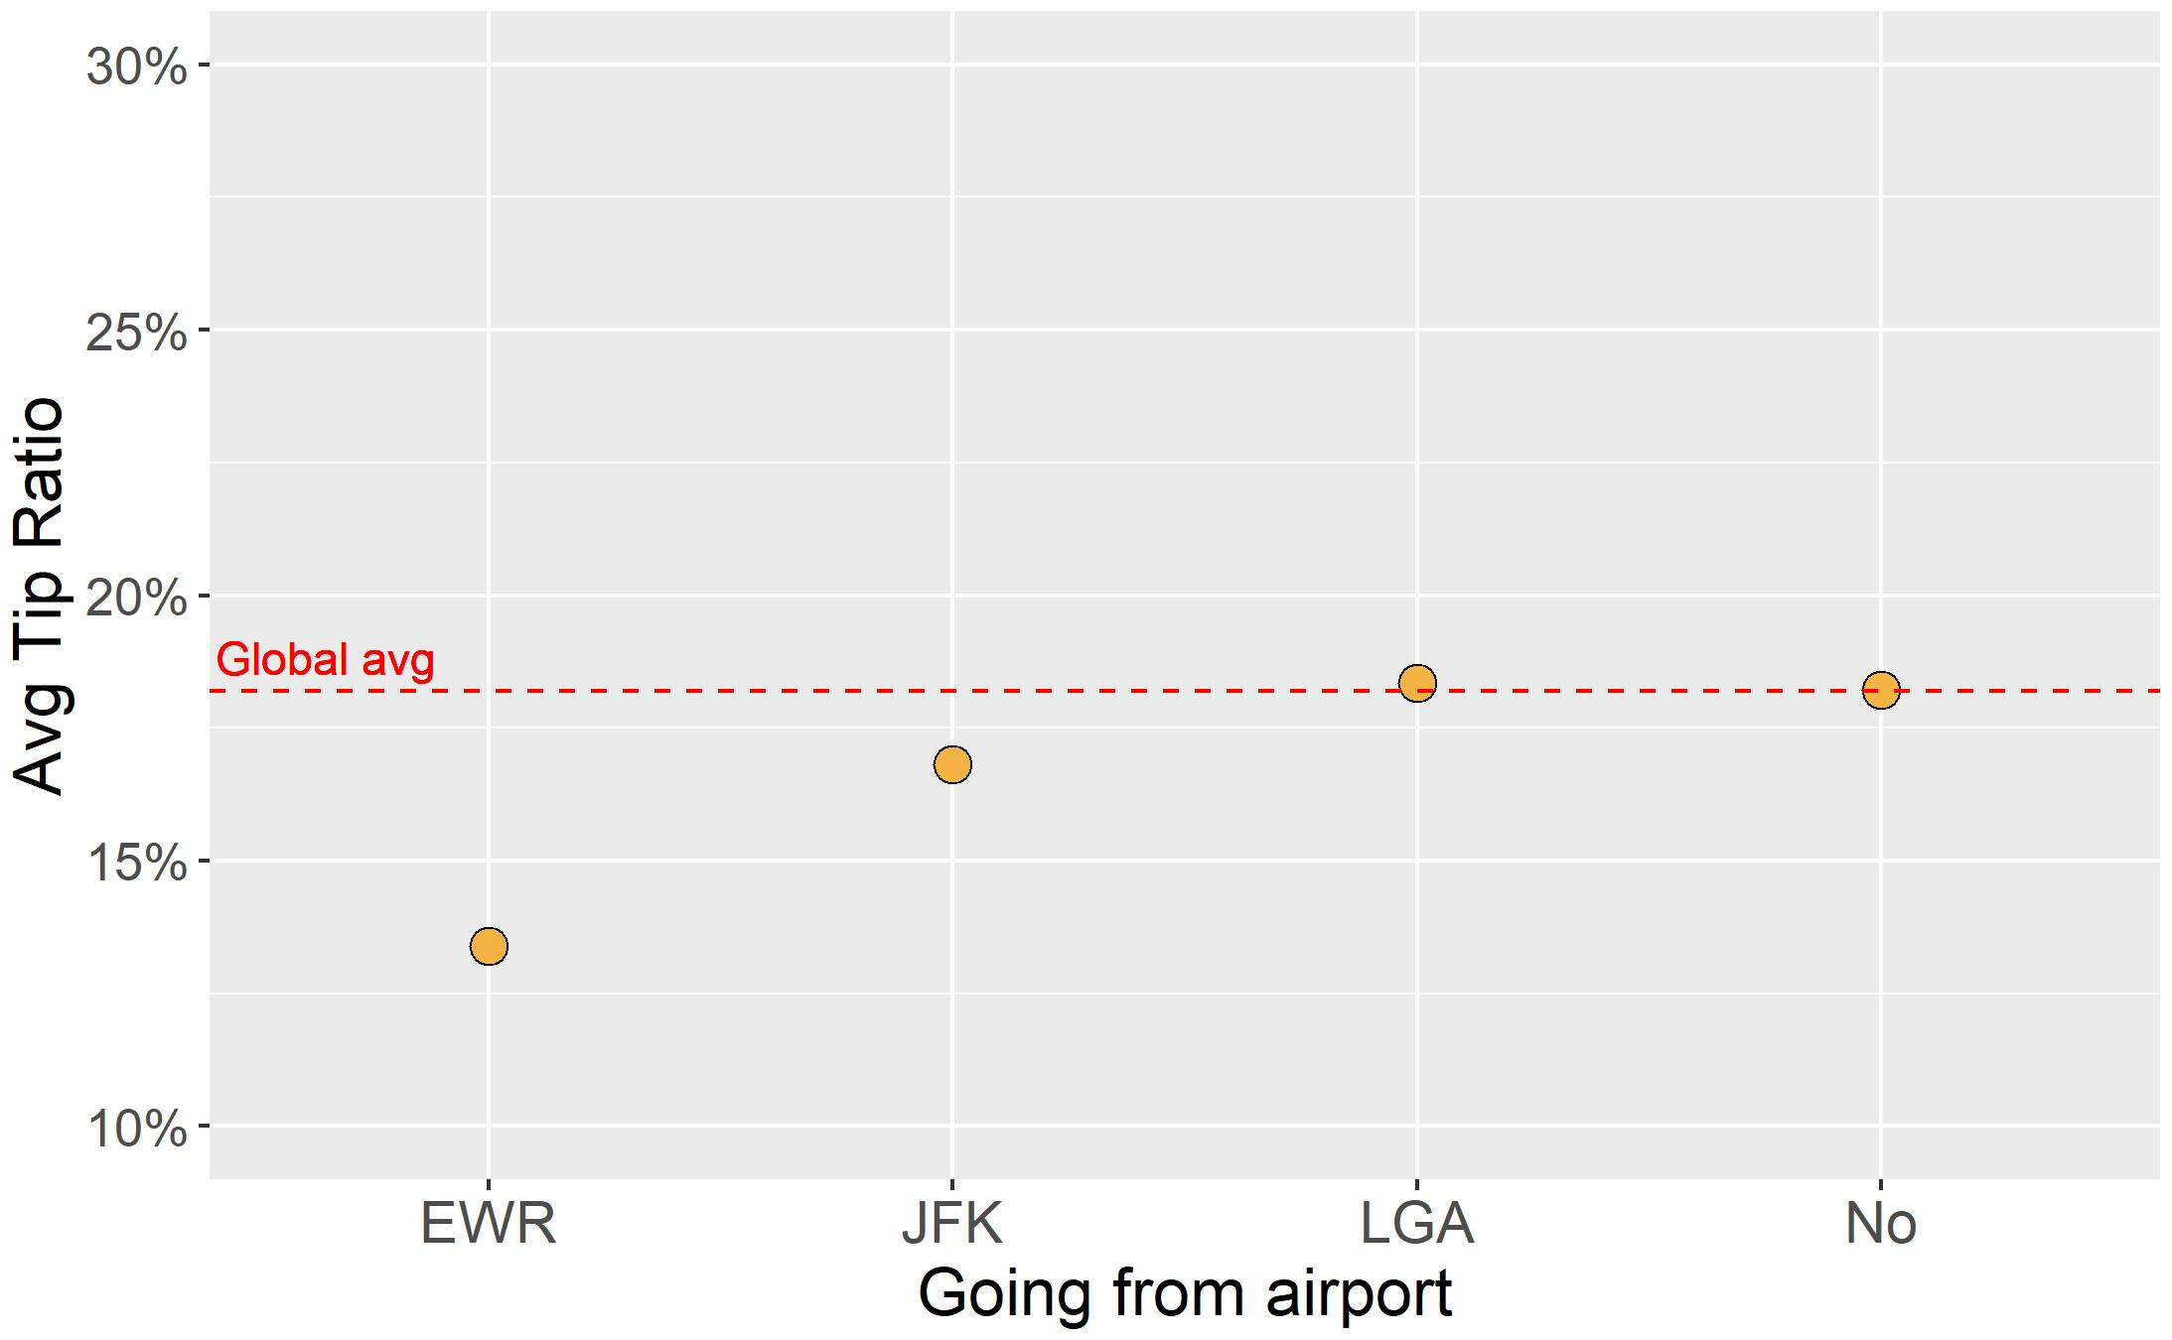
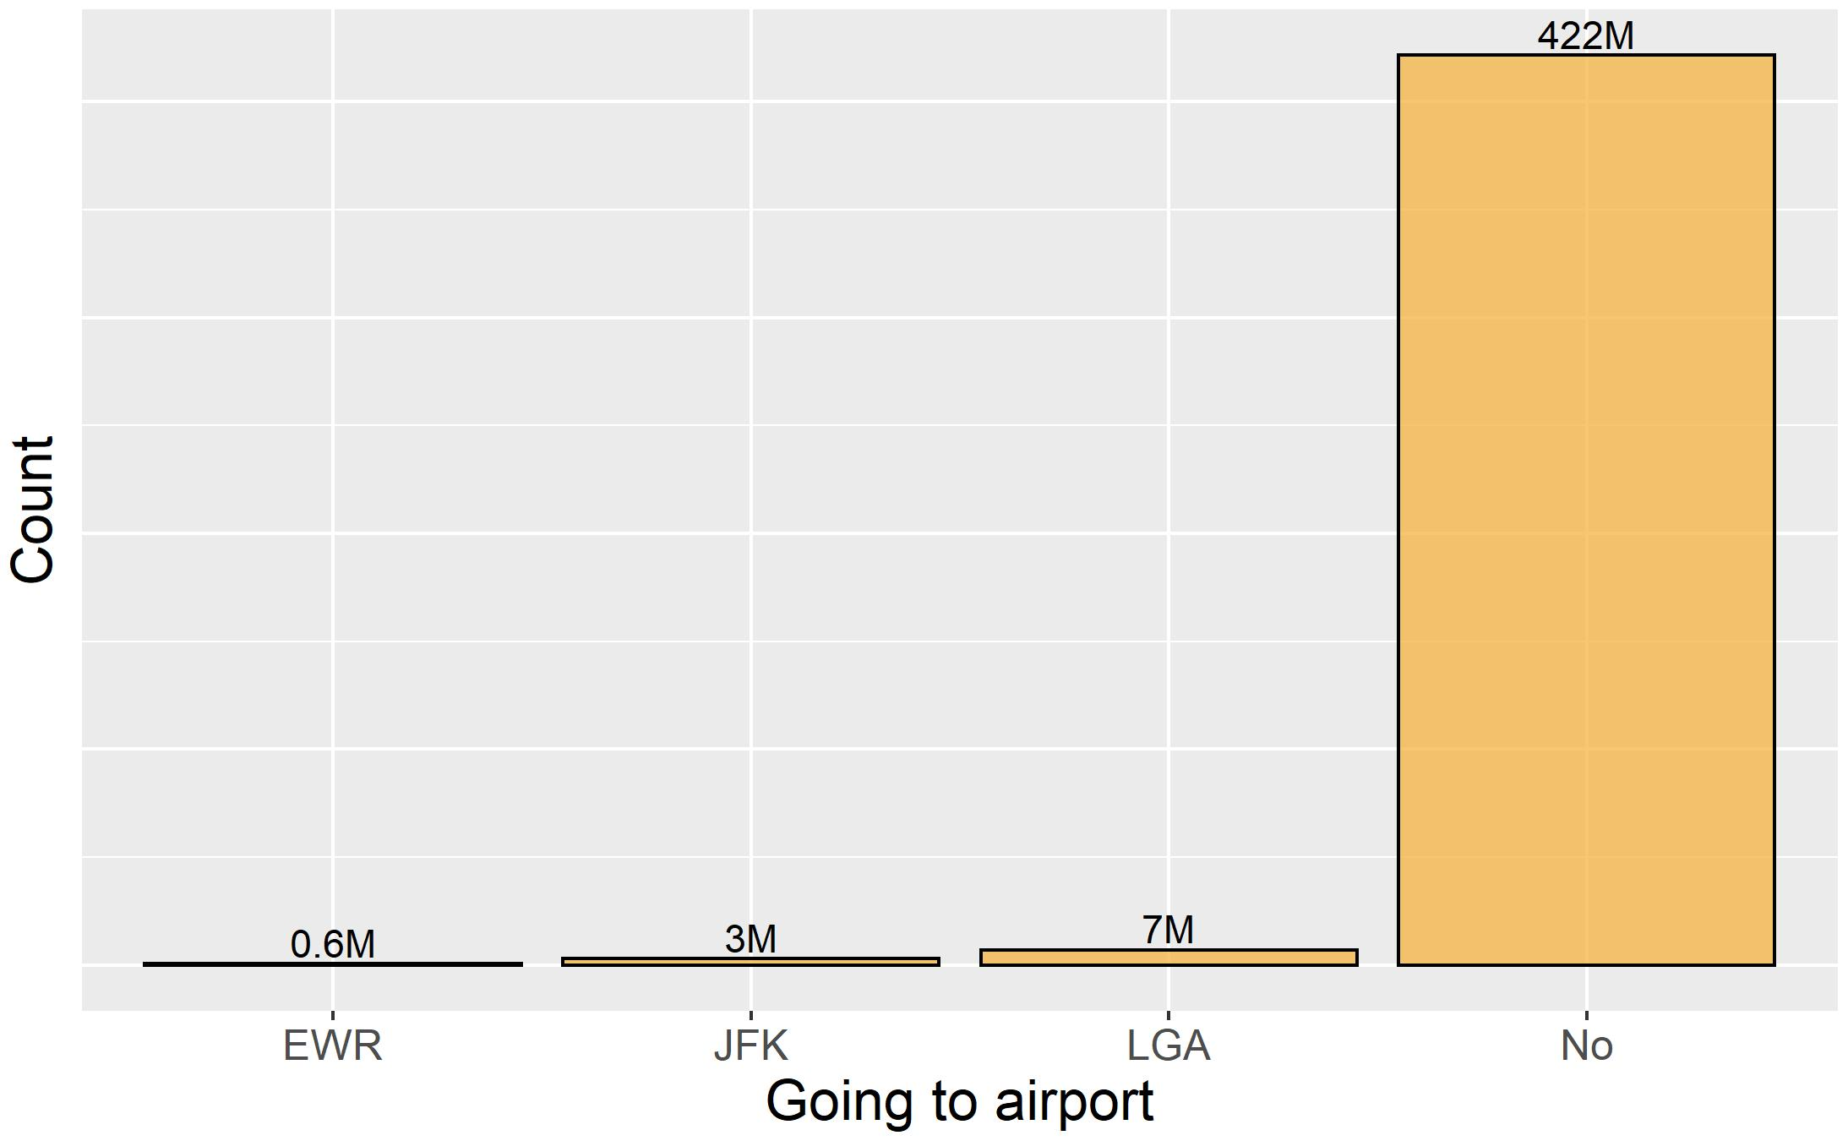
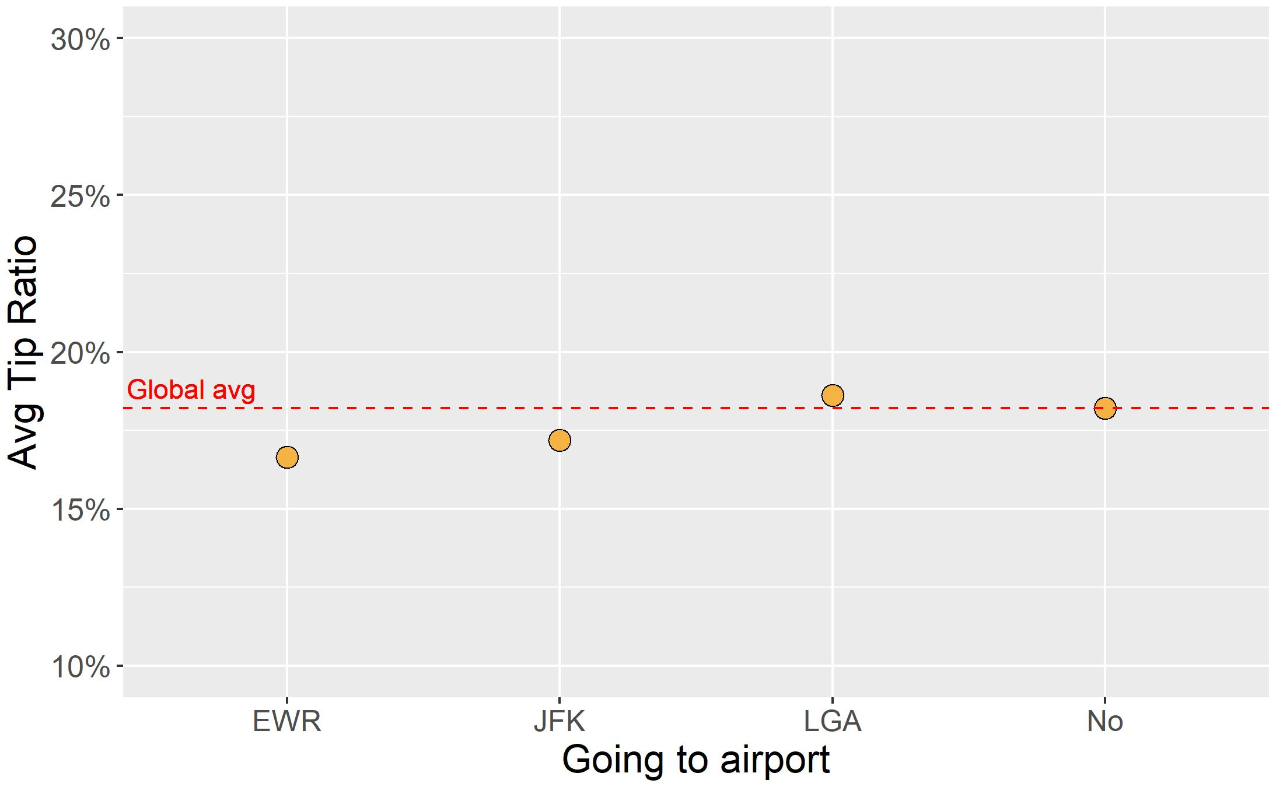

Slide 48
Weather-related features

Slide 49
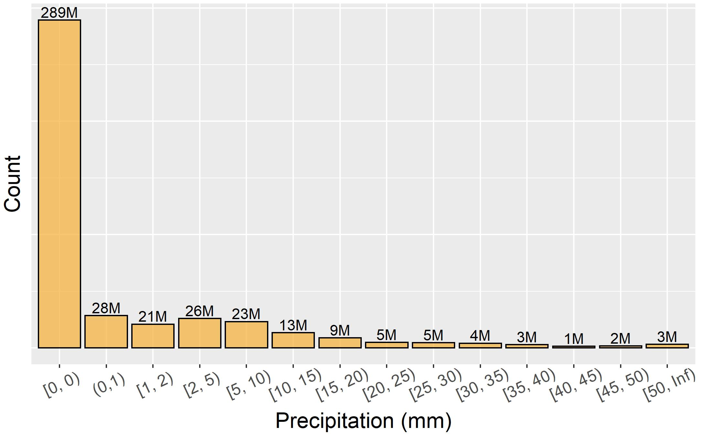
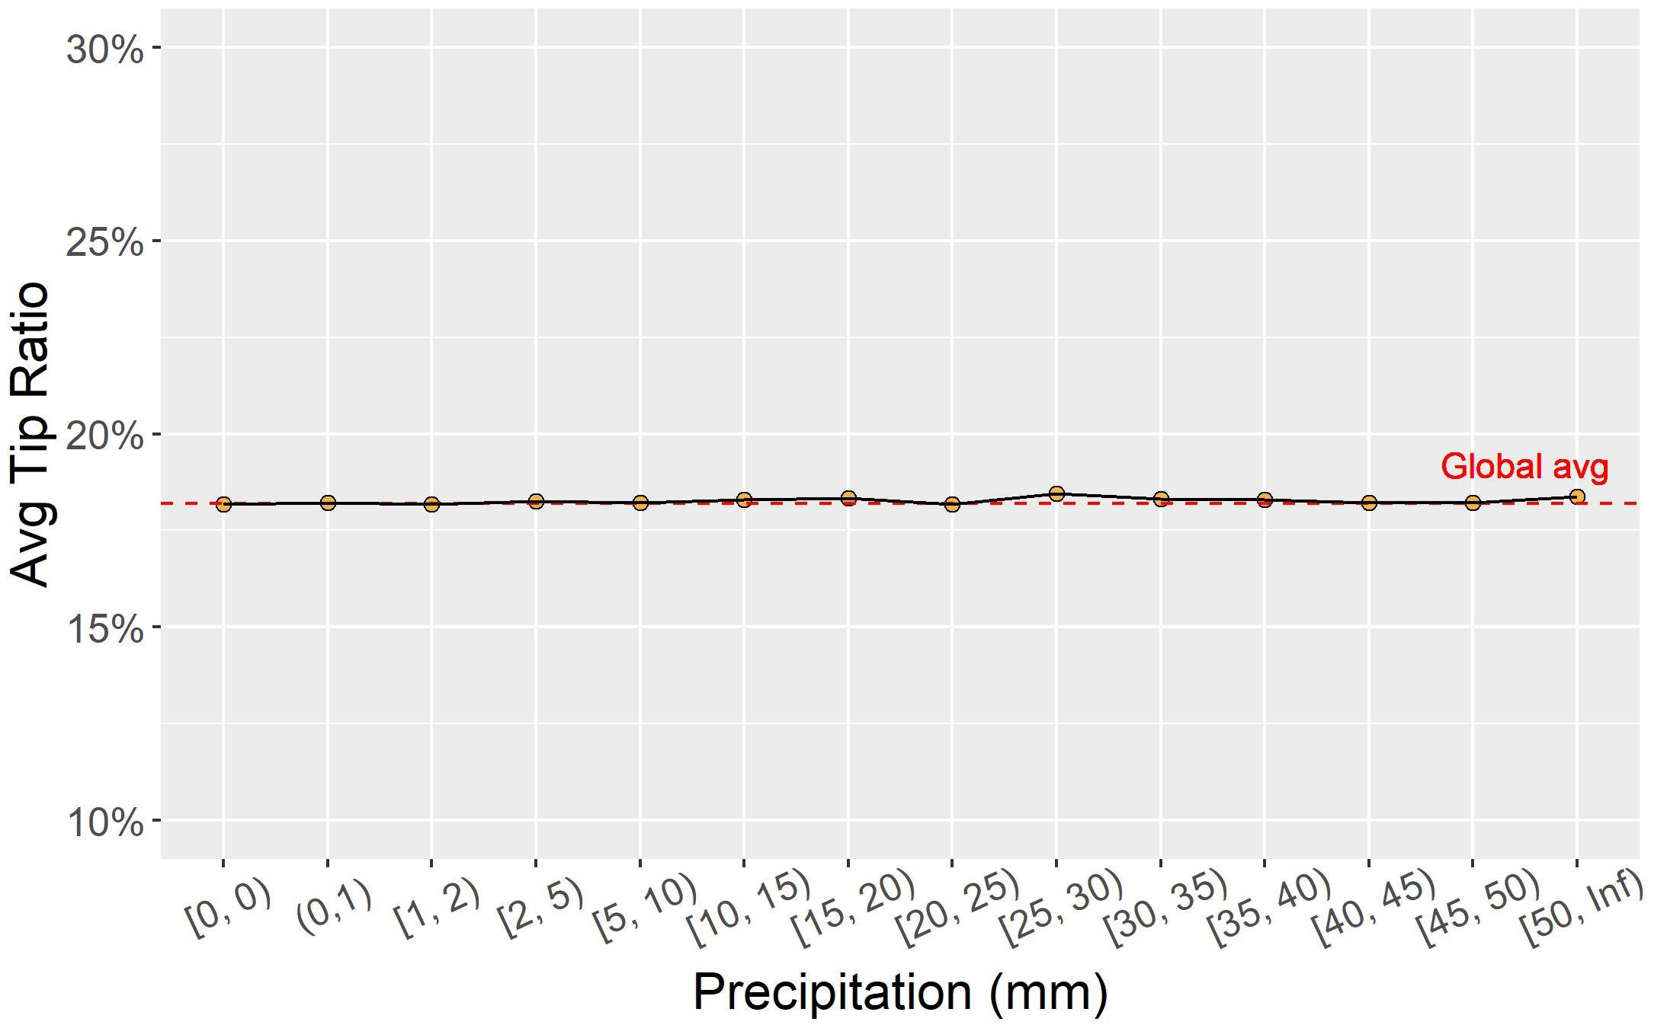
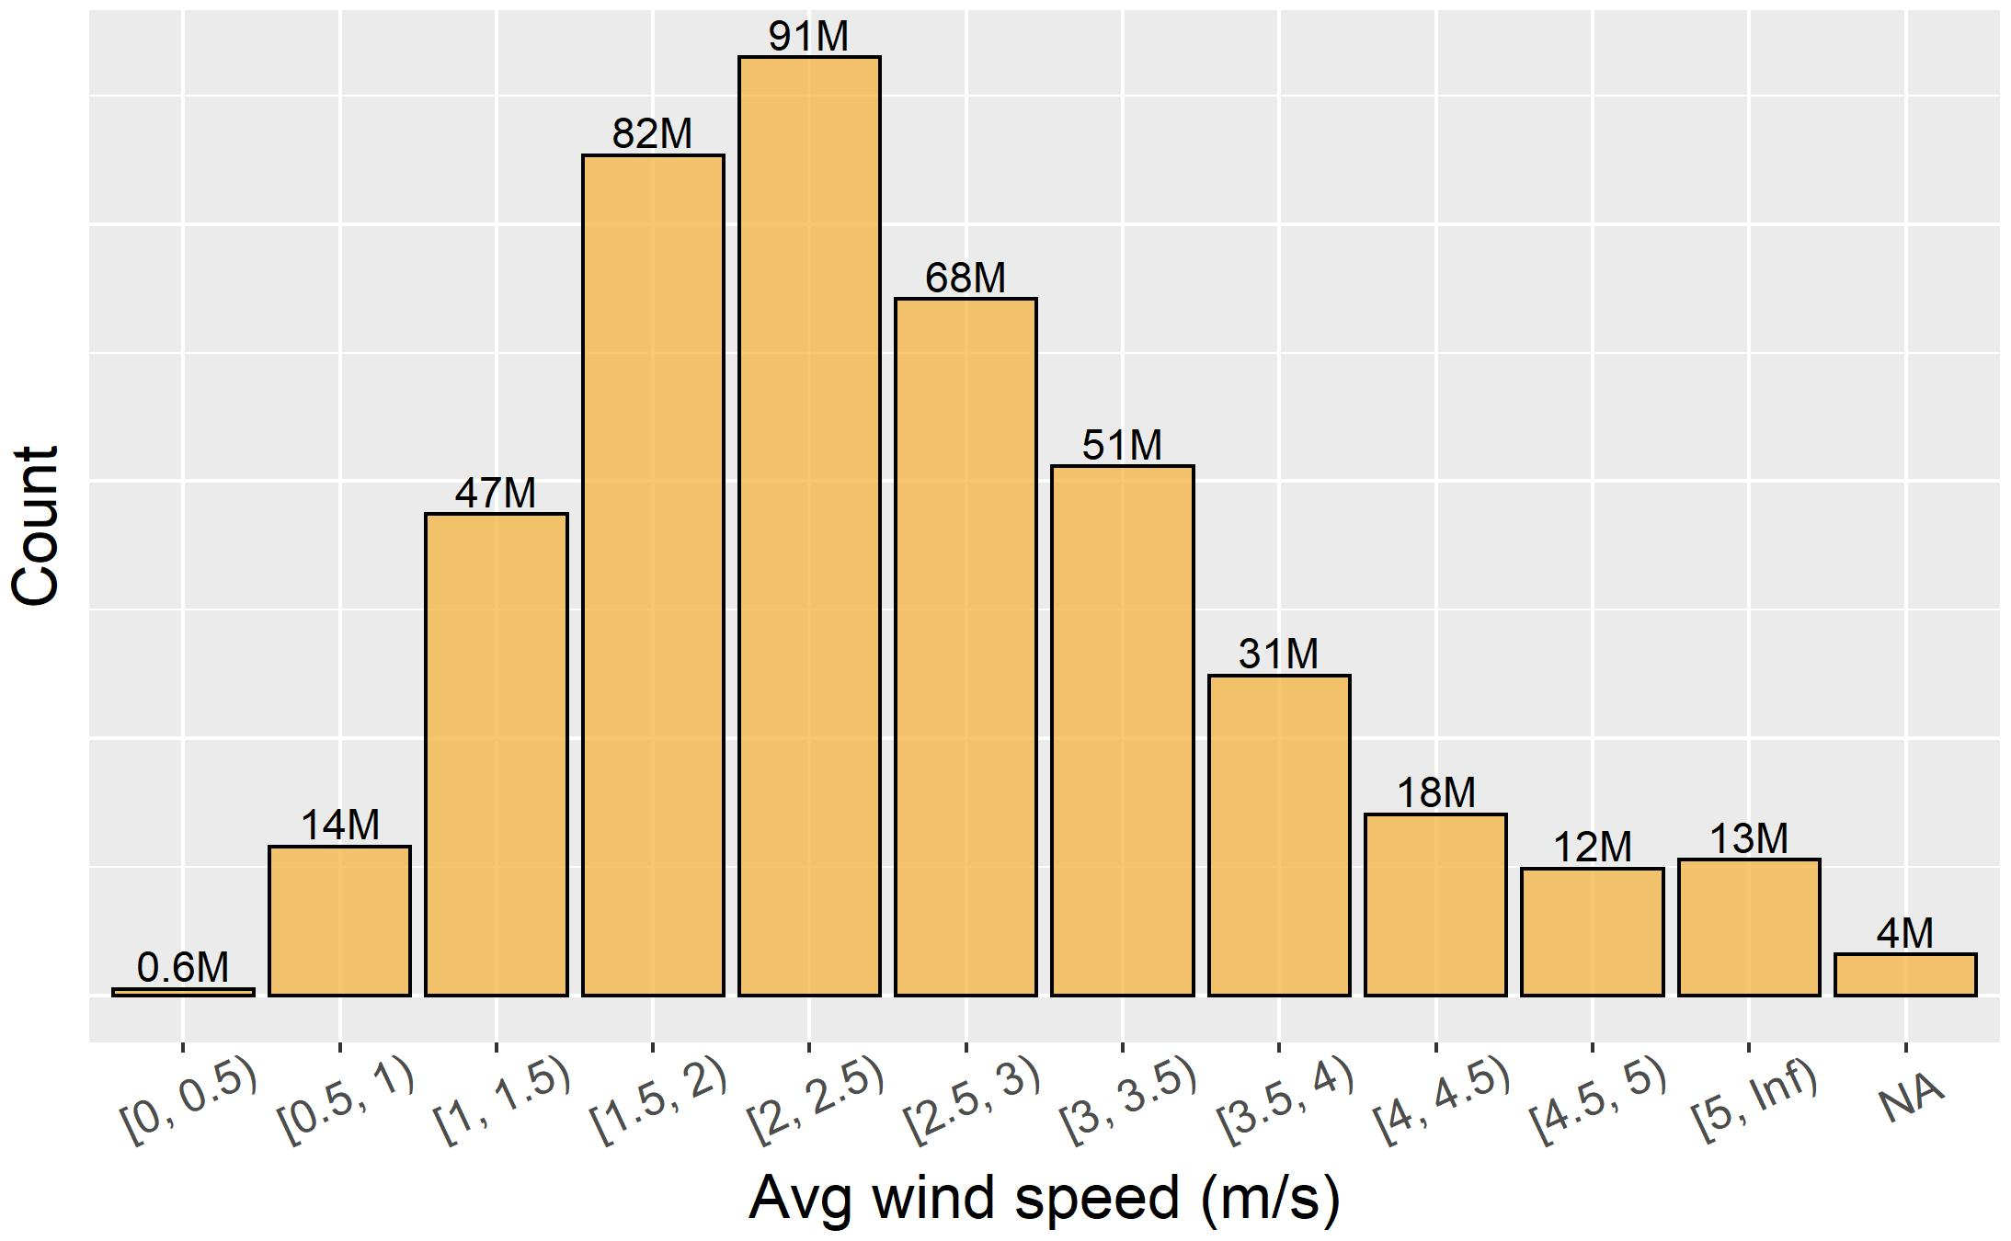
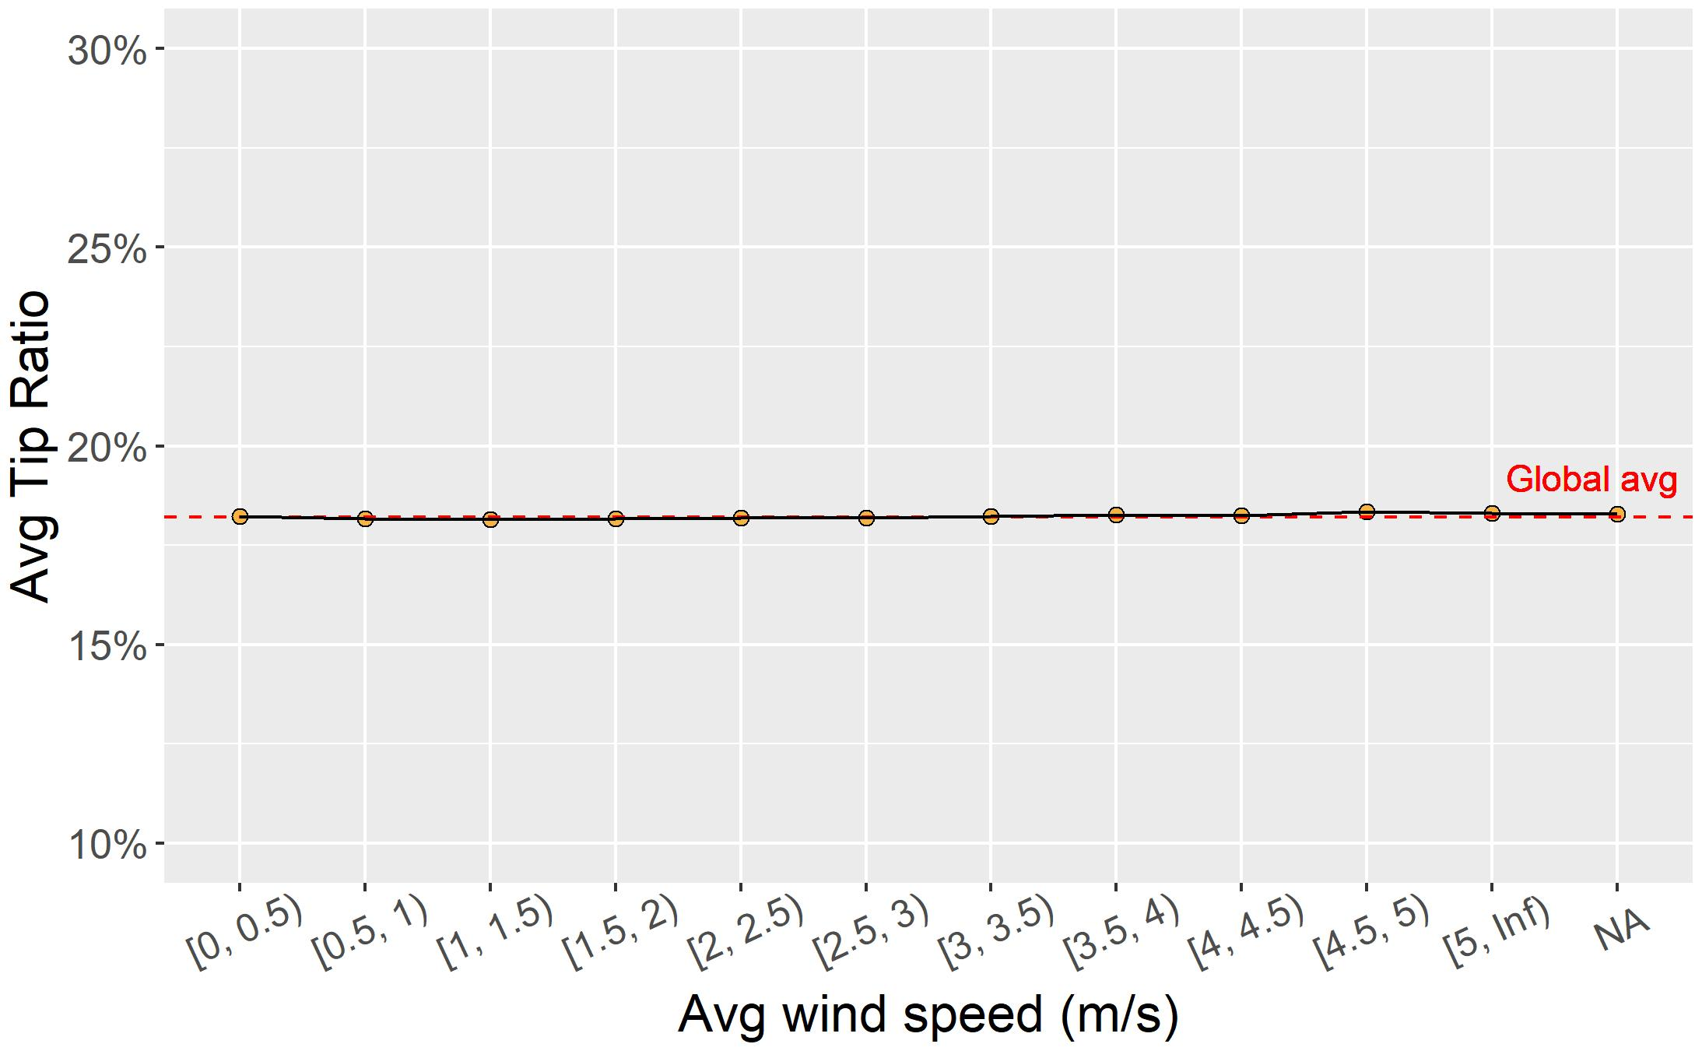

Slide 50
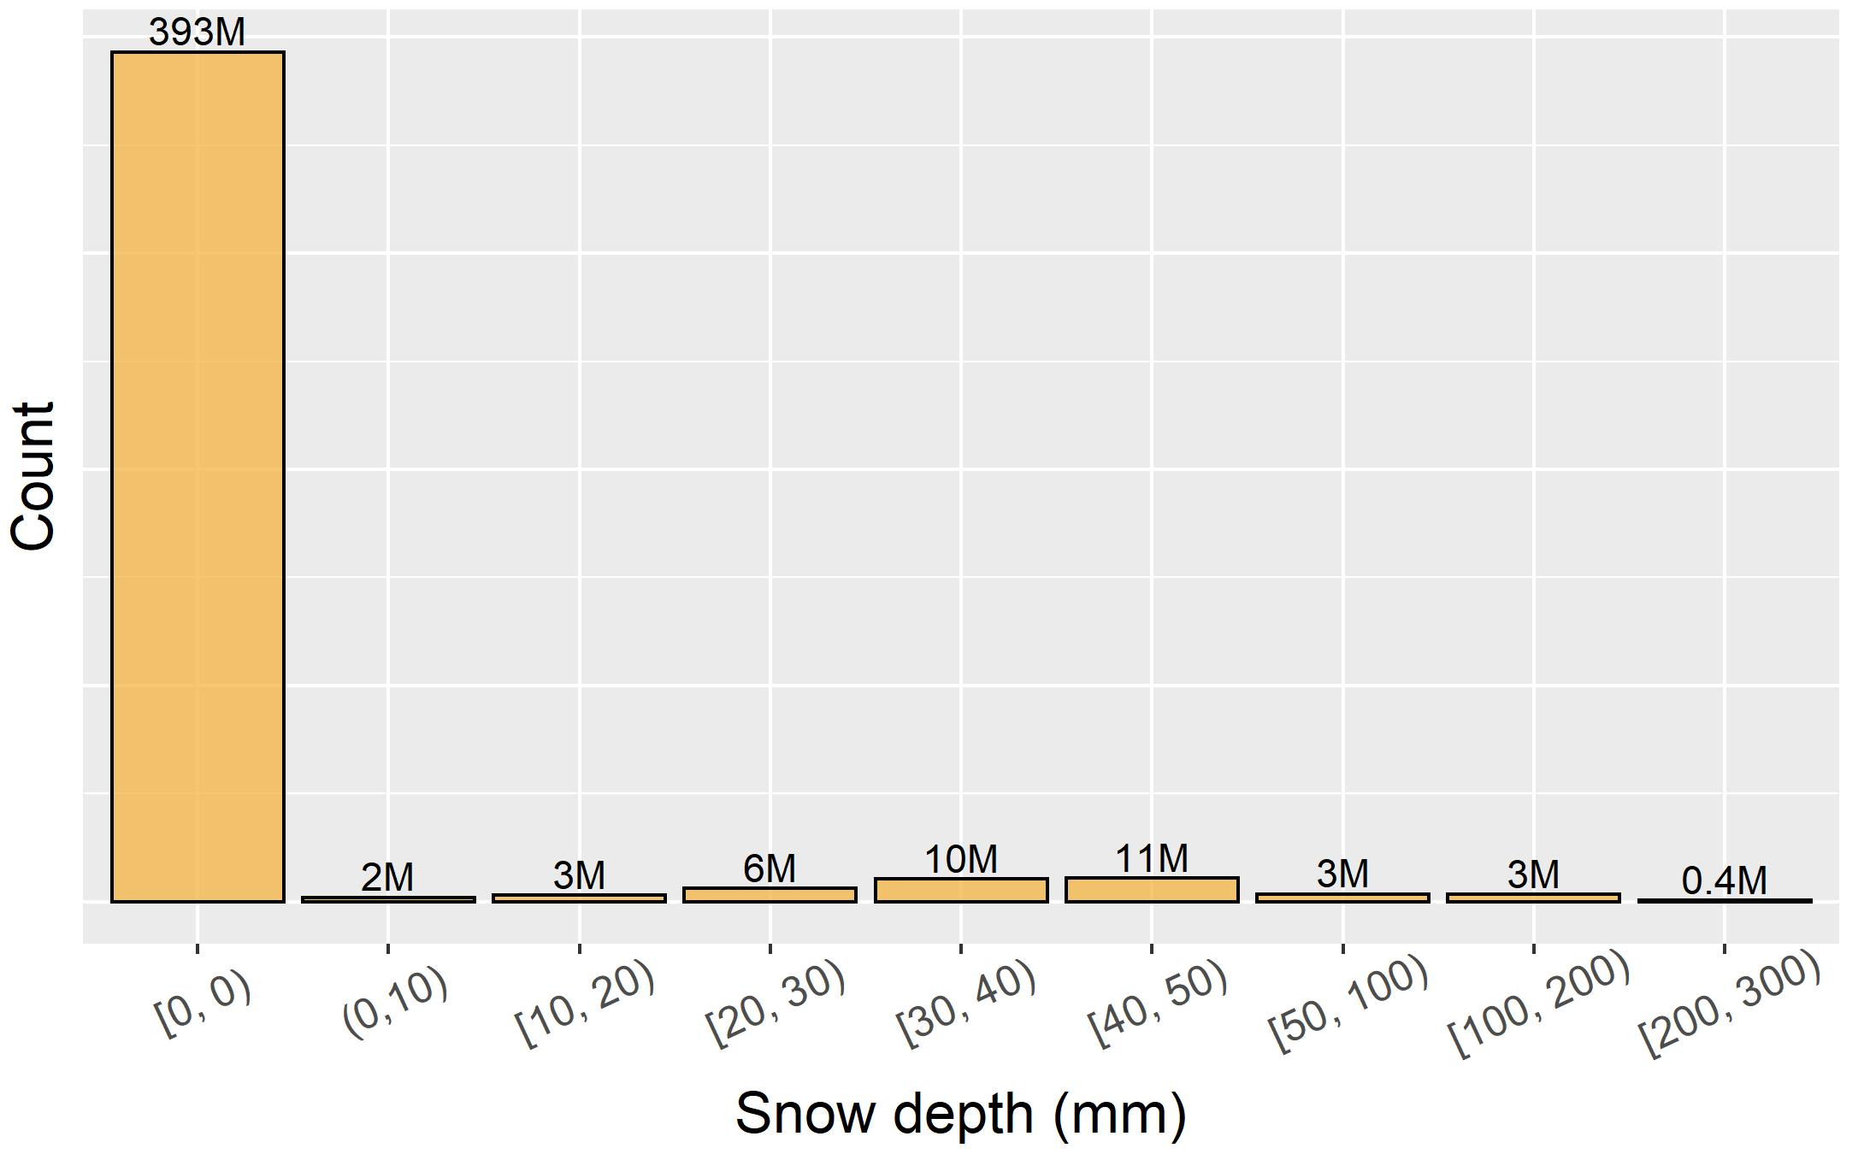
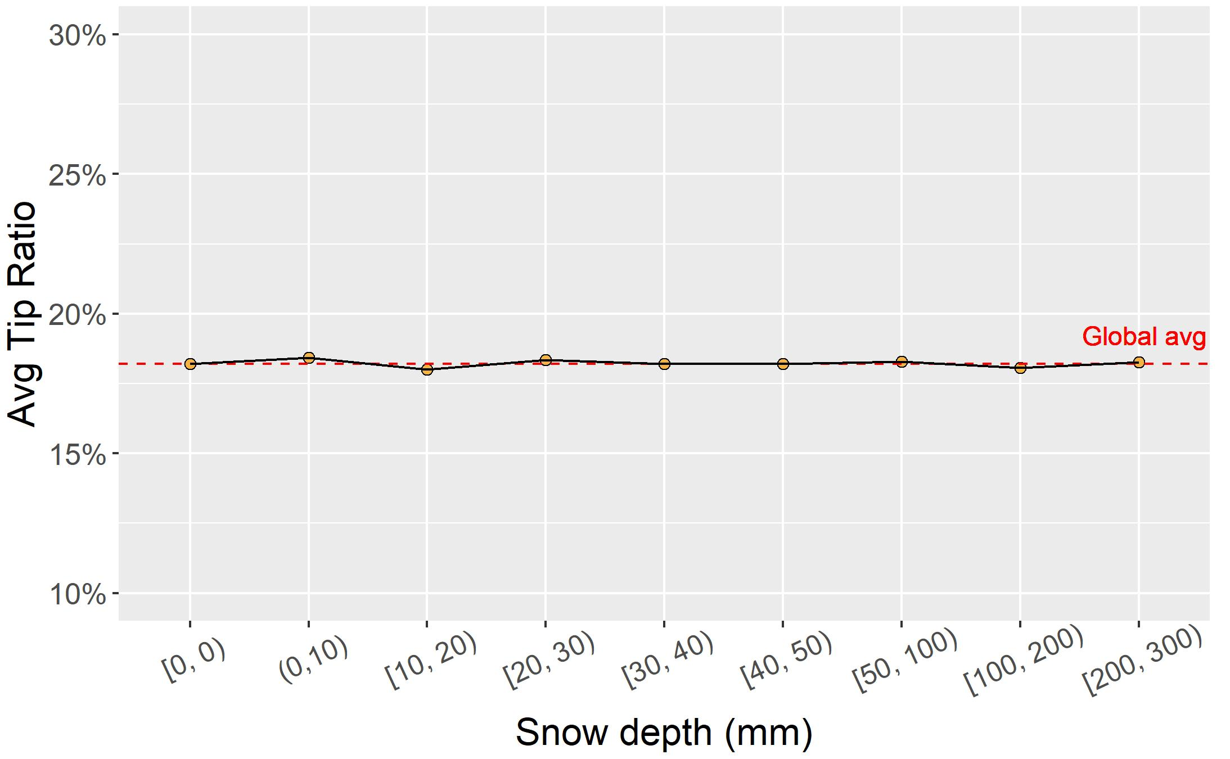



Slide 51





Slide 52
How to do it?
How I did it?
Data visualisation using sparklyr and ggplot2
Different approaches to big data visualisations:
Aggregating big data to concise tables
Sampling big data to smaller datasets
Directly plotting big data using dbplot

Slide 53

How to do it?
How I did it?
Data visualisation by aggregating

Slide 54

How to do it?
How I did it?
Data visualisation by sampling

Slide 55
3.4 Data mining

Slide 56
Feature selection
Features known before the ride (apriori):
ride type
ride hour
ride day of week
ride month
ride year pickup taxizone
pickup borough (area)
going from airport
Features known after the ride (aposteriori):
ride type
obligatory part
ride duration
average vehicle speed
direct (aerial) distance
ineffectiveness
ride hour
ride day of week
ride month
ride year
pickup/dropoff taxizone
pickup/dropoff borough (area)
going to/from airport
8
16

Slide 57

How to do it?
Data formatting

Slide 58

How to do it?
Splitting the dataset
Notes:
430 and 140 M rows

Slide 59

Available regression models in sparklyr

Slide 60

How to do it?
Example of training a regression model

Slide 61

Results

Slide 62


Feature importance

Slide 63




Residual analysis

Slide 64
3.5 Conclusion of the analysis and future work

Slide 65
Conclusion of the analysis and future work
23 features considered
3 models trained
poor results
predicting tips is a difficult task
little correlation was found between the taxi ride’s tip percentage and its weather-related or its performance-related features
strongest predictor was the ride’s obligatory price
Social pressure is the strongest motivator for tipping

Slide 66

Thank you for your attention! Questions?

